Slide 1
肯纳曲轴连杆高效切削的解决方案
发动机领域

Slide 2
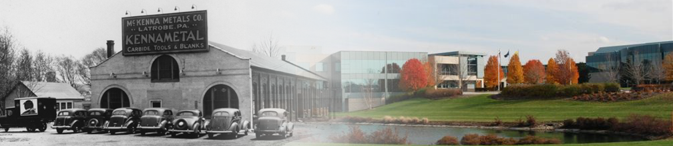
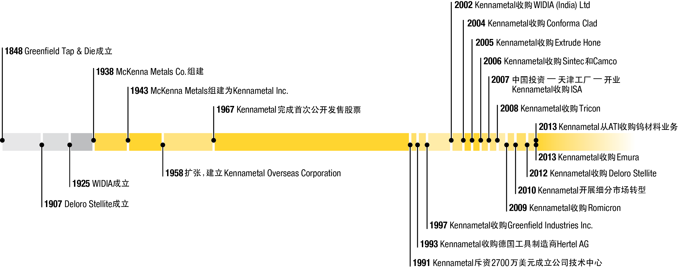
公司简介
深厚积淀，进取精神
Notes:
Kennametal 公司，始建于 1938 年的技术创新，我们一直在不断地推陈出新。
2002 年，我们收购了一家创建于 1925 年的 WIDIA 公司。事实上，我们收购 Greenfield Tap & Die 之后，我们最早的品牌可追溯至 1848 年。
我们首先在宾夕法尼亚州拉特罗布打开了大门，我们的全球总部也设在那里。今天，Kennametal 业已成为一家全球性公司，我们在北美地区以外实现的销售额超过总额的 50%。
我们凭借着雄厚的技术底蕴，推动业务走出国门，走向世界。
我们的公司发展依靠的是扎实的基础和创业思维。
2013 年，我们从 ATI 收购了钨材料业务。此次收购进一步增强了我们的模具产品组合，加快了我们的先进碳化钨设施开发计划，促使我们在关键增长市场的发展，包括航空航天、能源及相关工艺产业。

Slide 3
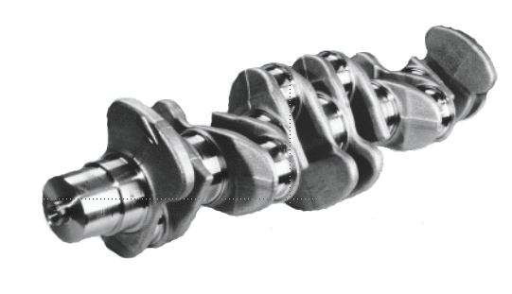
曲轴加工
曲轴加工刀具简介
曲轴加工通用类刀具
曲轴加工特有工序
    车车拉
    车拉
    外铣
    内铣

Slide 4


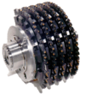









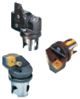
曲轴刀具综合解决方案
行业解决方案 – 粗加工
较高的生产效率
较好的灵活性
行业解决方案 – 精加工
保证最小跳动的调节方式
深孔钻削
应用于20至30倍直径比深的内孔加工
加工铸铁和钢件类材料
行业解决方案 – 粗加工
较高的生产效率
较好的灵活性
车拉刀具
适合粗精加工
应用多个曲轴回转中心
内铣刀体
轴承档的粗精加工
外铣刀体
轴承档的粗精加工
车车拉刀具
应用中心回转轴承的粗精加工
Dodeka / Octacut
曲轴端面的铣削
HSC Auto Speed VME 195
全自动检测外铣刀体
全自动检测车车拉刀体
„Hollow-Mill“-Cutter
粗加工法兰式结构
大直径粗加工刀体
车削刀具
粗精加工法兰结构
具有直径变幻的粗精加工刀具形式

Slide 5
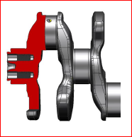
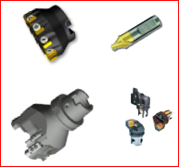
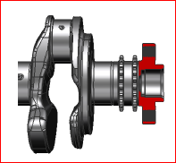


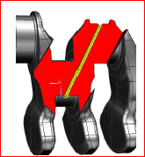

曲轴通用类刀具概述
铣削两端面和中心孔加工
车削
钻削，铰削和攻丝法兰面孔系
油孔加工

Slide 6
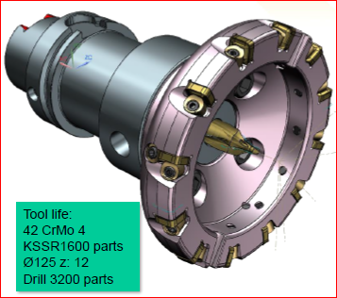
曲轴通用类刀具概述
铣削两端面和中心孔加工

Slide 7
曲轴通用类刀具概述
首选---分体式结构
可调整刀夹
最大的铁屑排屑空间
内冷支持
维修简便
通用性广

Slide 8
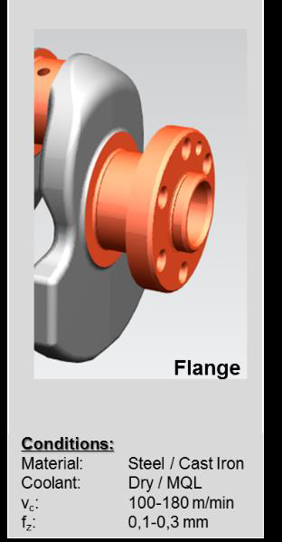
曲轴通用类刀具概述
整体式结构
可微量调整
最强的刀具刚性
最多的刀齿分布
内冷支持

Slide 9
曲轴通用类刀具概述
HSK100A
直径D87-D41
Z=2
可调整刀夹
刀片1*SPPX09T308
刀片2*SPPX120412
切削钢件
切削速度：Vc=150m/min
进给： fz=0.2mm

Slide 10
曲轴通用类刀具概述
HSK100A
直径D30-D40
Z=2
4个可调整刀夹
刀片4*SPPX120408
切削钢件
切削速度：Vc=150m/min
进给： fz=0.2mm

Slide 11
曲轴通用类刀具概述
HSK100A
直径D85
Z=3（端面Z=1）
整体式结构
刀片SNMU120612
切削钢件

Slide 12

曲轴轴径类刀具
TTB
OD
ID
适用性
加工时间
刀具结构复杂
加工公差
适用性
加工时间
刀具结构复杂
加工公差
-
适用性
加工时间
刀具结构复杂
加工公差
适用性
加工时间
刀具结构复杂
加工公差
适用于大批量生产相同类型的曲轴
只加工主轴承档
单独的车车拉生产线
车车拉 + 外铣复合
车车拉 + 内铣复合
曲轴优化生产线
车车拉 + 外铣复合
重载粗加工
车车拉 + 内铣复合

Slide 13
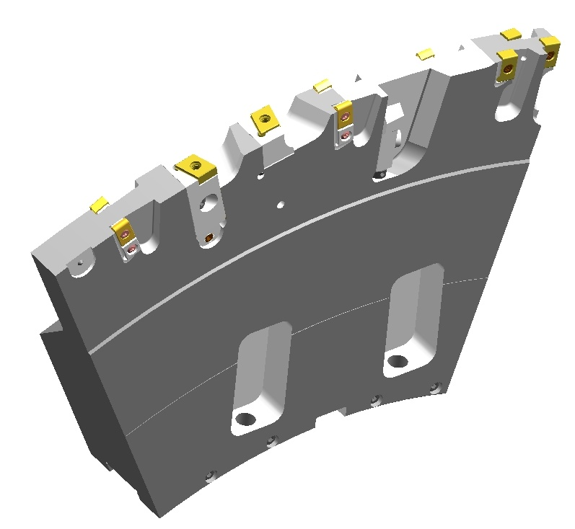
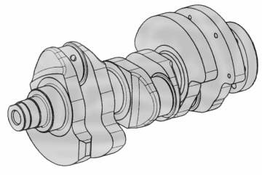
车拉刀具
粗加工:
- 切削速度.: 140 ... 200 m/min
- 进给量: 0,25 ... 0,5 mm⁻¹
精加工:
- 切削速度.: 160 ... 220 m/min
- 进给量: 1800 ... 2400 mm/min
最快的加工方式
高性能硬质合金牌号

Slide 14
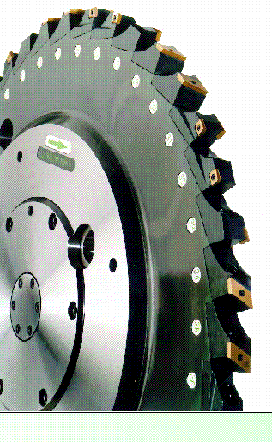
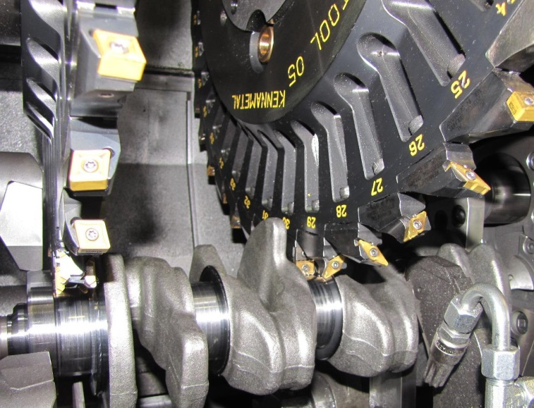
车车拉刀具
粗加工:
- 切削速度: 140 ... 200 m/min
- 进给量: 0,25 ... 0,5 mm⁻¹
精加工:
- 表面质量: R_{z} 4 ... 6 µm
-切削速度.: 160 ... 220 m/min
-进给量: 1800 ... 2400 mm/min
改进的系统
尽可能的 ISO 标准刀片
高性能的硬质合金牌号

Slide 15
车车拉刀具刀夹

Slide 16
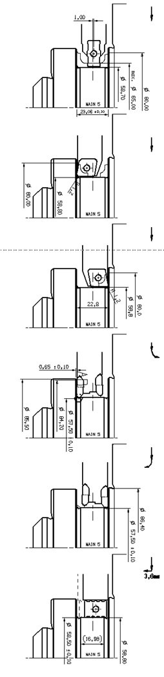
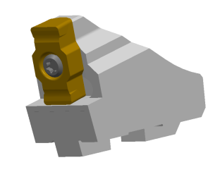
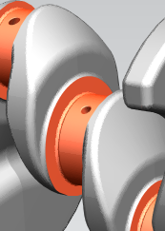
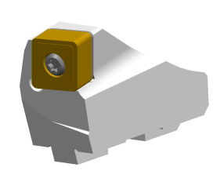
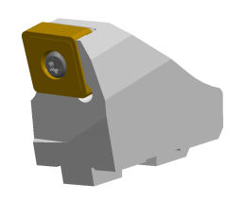
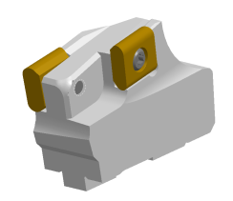
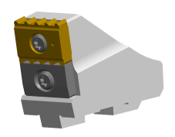
车车拉刀具刀夹
主轴颈加工

Slide 17
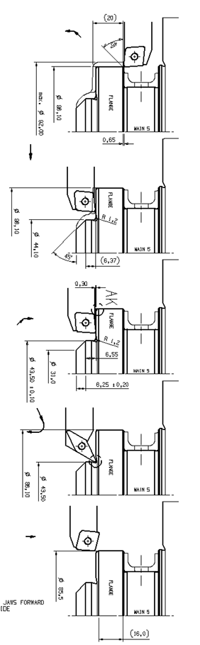
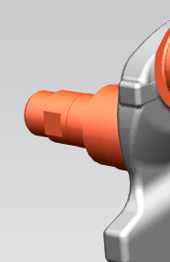
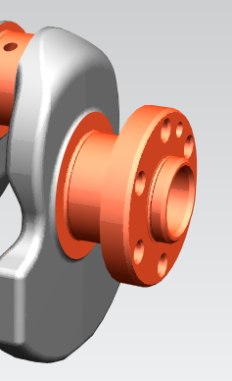
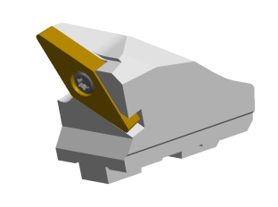
车车拉刀具刀夹
主轴颈加工

Slide 18
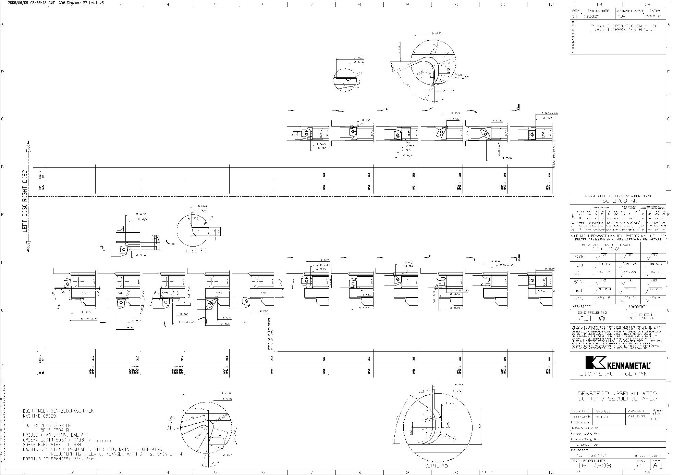
车车拉刀具刀夹
Notes:
Innovation is at the heart of Kennametal’s competitive advantage
In locations including Latrobe, Bedford, Rogers and Evans in the US and Fürth in Germany and Bangalore in India we have more than a thousand research scientists and development engineers
Using a stage gated process, ACE, we focus on customer needs to design products that will make our customers more productive
Focused on customer needs
Developing new cutting tool & wear resistant materials
Designing products to make our customers more productive
We emphasize and reward employees who create patentable innovation
Kennametal named a Best-Practice Partner by the APQC
for outstanding practices in innovation. After surveying 100 major corporations in the United States known for their innovation, Kennametal was recognized for efficiencies in ACE, and the company’s overall definition of innovation.

Slide 19
快换式内铣刀结构
内铣刀体操作简易
换刀装卸装置
优势：
夹紧环是仅有的一种附件
可以进行手动换刀（刀具重量在9~14KG）
刀具
刀盘
夹紧环

Slide 20
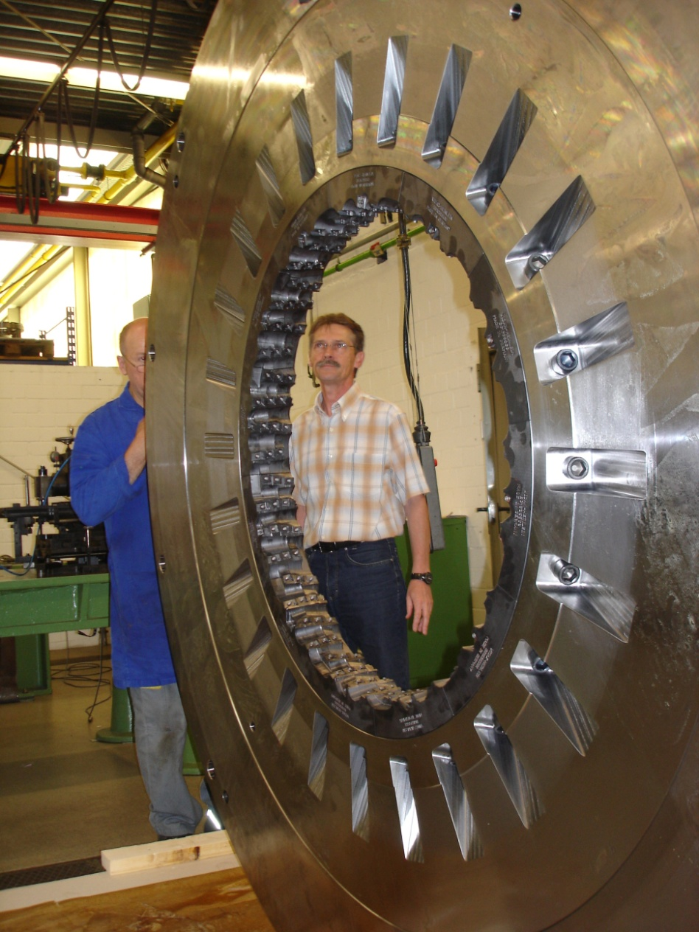
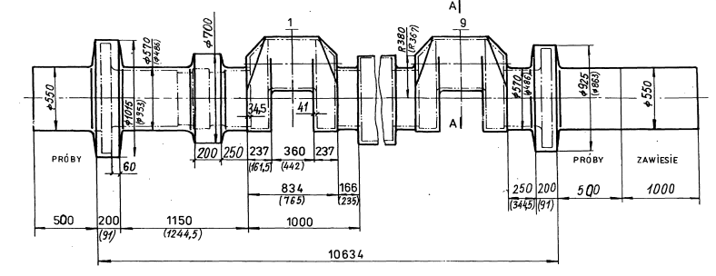
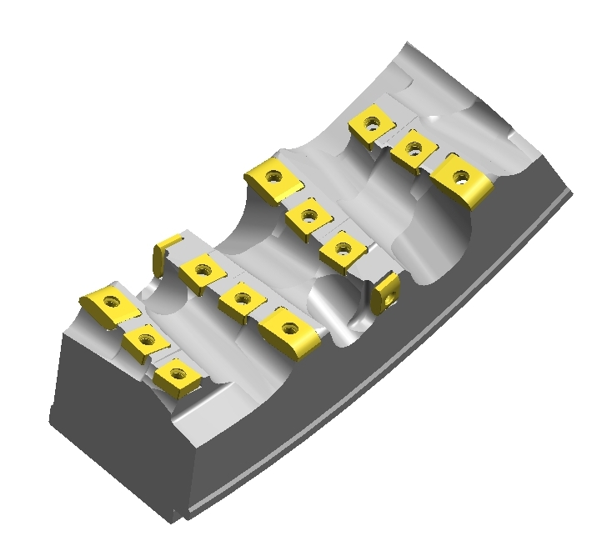
内铣刀具
HNK韩国
内径 = 1250 mm
宽 = 75 mm

Slide 21
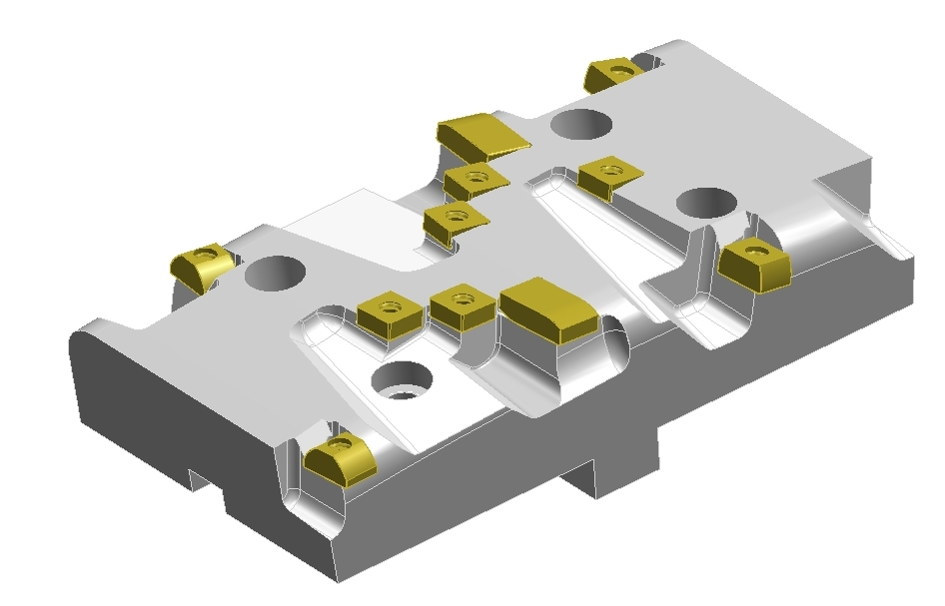
内铣刀具
刀片的排列是有很多种不同的摆放形式
每个不同的项目都必须依据其特殊要求而设计
在刀片排列中必须要考虑到铁屑的排出
在刀片排列设计中多齿的刀体上必须考虑有足够大的容屑空间

Slide 22
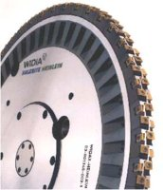
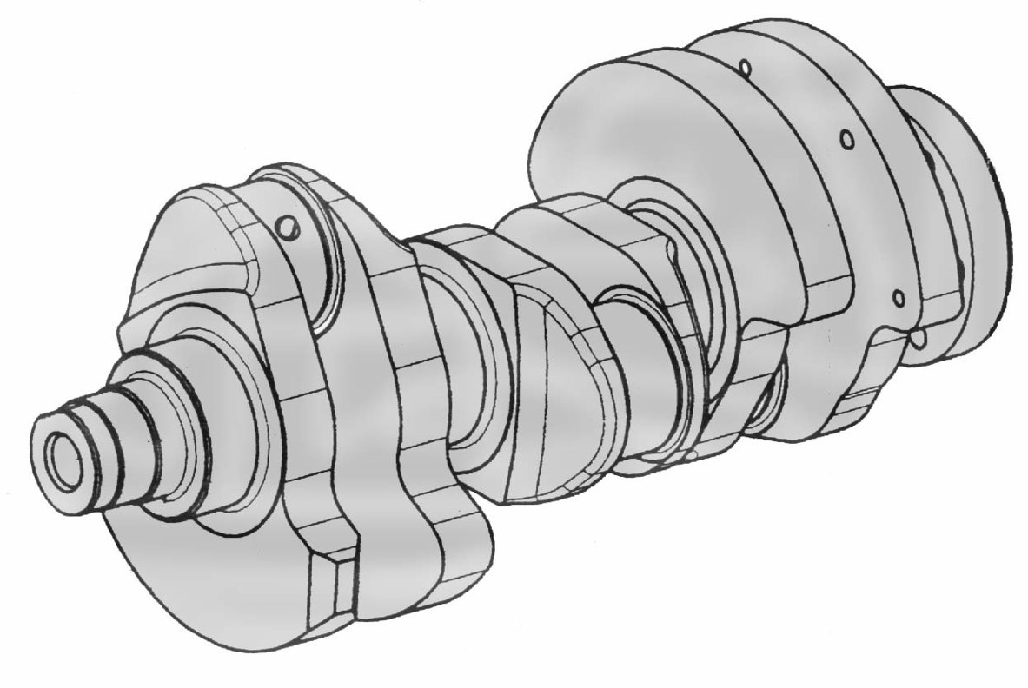
外铣刀具
超密齿刀体
高精度
高精度结构（带调整选项）
HEINLEIN
粗加工:
- 切削速度.: 180 ... 250 m/min
- 铁屑厚度: 0,25 ... 0,30 mm
精加工:
-切削速度.: 200 ... 350 m/min
-铁屑厚度: 0,15 … 0,22 mm

Slide 23

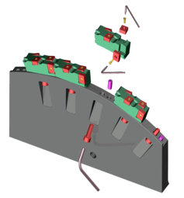
外铣刀具
轴向固定:
- 基准面磨削
刀夹
较高重复定位精度
较小的跳动值
夹持
刀体
径向固定:
- 内六角 M10
- 清洁简便
- 操作顺手
- 标准螺钉
HEINLEIN
切线方向:
- 销钉
- 可靠的夹紧方式
刀夹设计

Slide 24
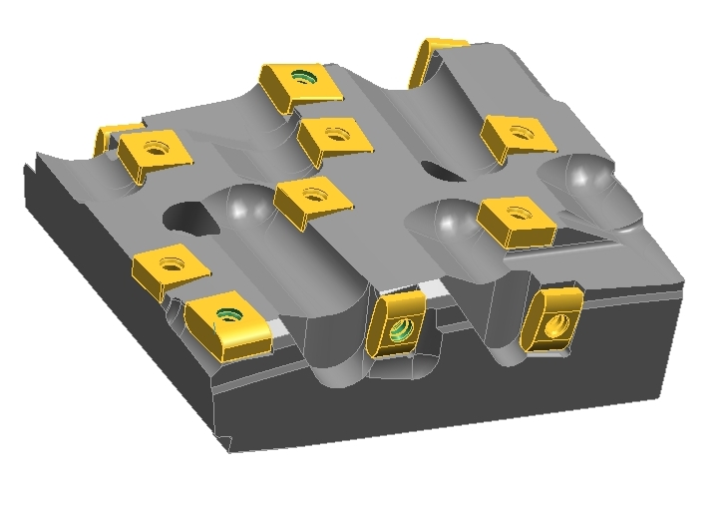
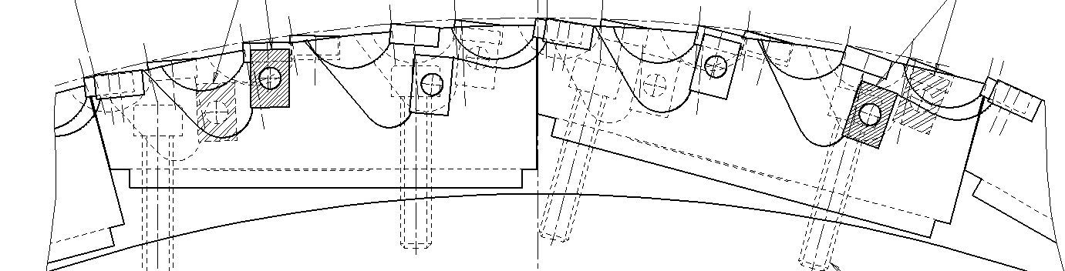
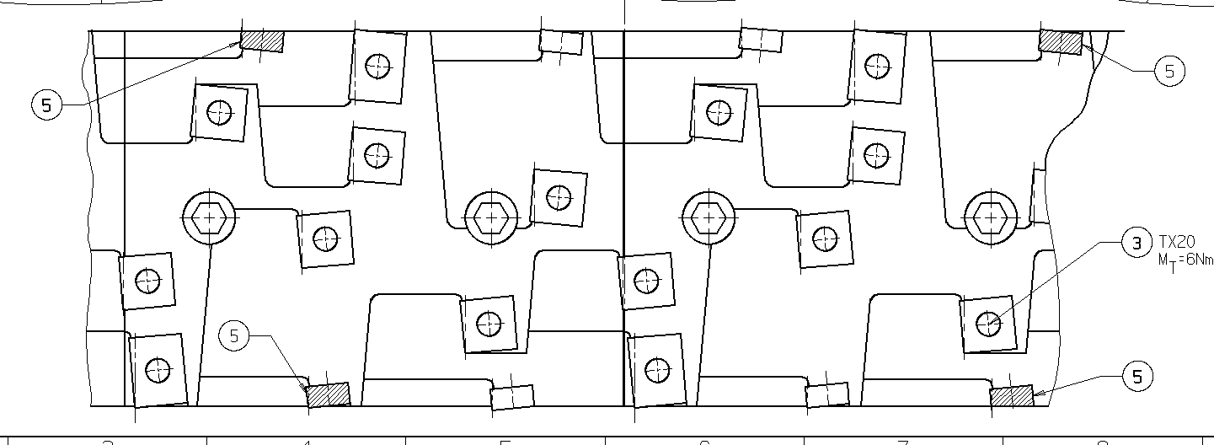
外铣刀具
MHI (1573555)
直径 = 1150 mm
宽 = 75 - 120 mm

Slide 25
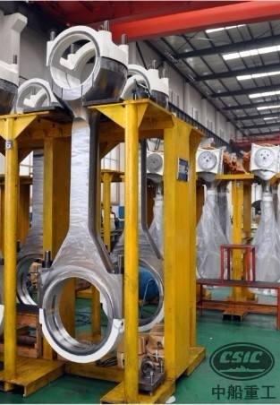
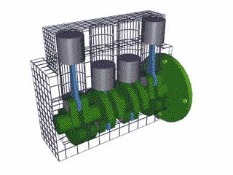
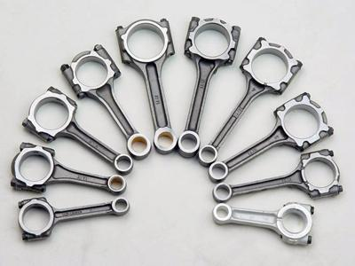
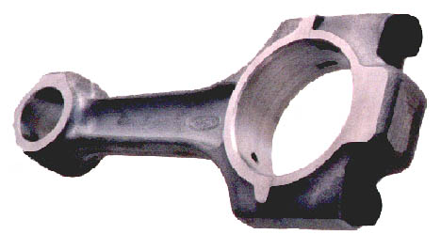
连杆

Slide 26
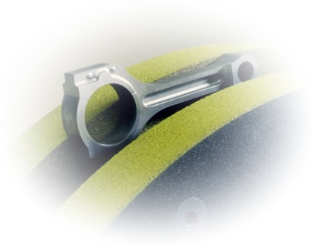
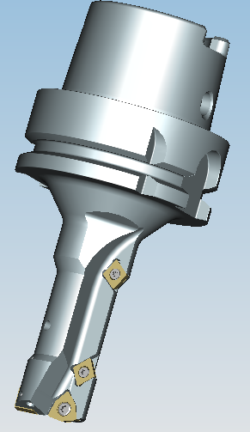
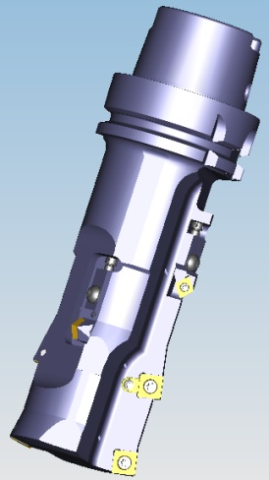
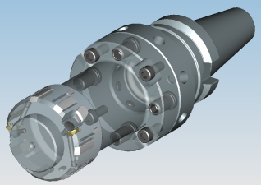
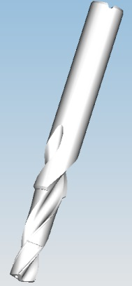
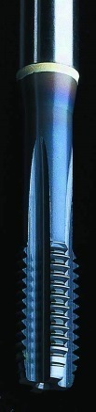

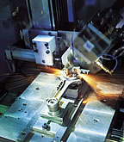
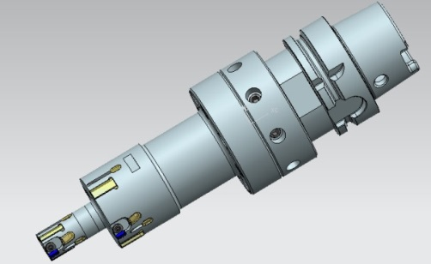
加工工艺
毛坯
2端面加工
大小头的粗加工
小头的精加工
螺栓孔加工
涨断/切断
合盖装配
小头压套
大/小头精加工

Slide 27
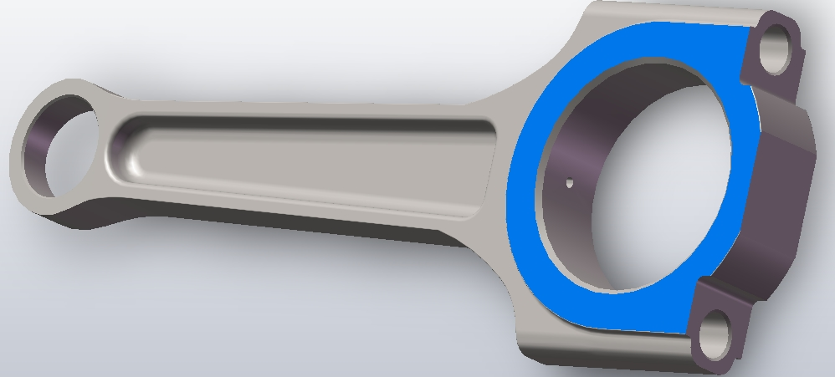



铣削止推面

Slide 28

铣削止推面案例
The Task:
STEEL
The Data:
Component: Pass. car conrod
Material: C70 S6 BY
Operation: Milling thrust faces
Coolant: no
Machine: Transferline
Objective: Achieve surface finish Rz 16
D = 100 m/min
Vc = 180 m/min
Vf = 1030 mm/min
FPT = 0,12 mm
DOC = 1,7 – 2,0 mm
The Solution:
HSK80C shell mill arbor with exchange lock
M780 milling cutter Ø100; z=12 + 3
3x Finishing insert SNXF1204ZNSNGP TN7525
12x Roughing insert SNXF120412SNGP TN7525
Offset of wiper insert 0,02 mm
The Results:
Surface finish Rz 5 - 6

Slide 29

小头孔加工案例
The Task:
STEEL
Component: Pass. car conrod
Material: C70 S6 BY
Operation: Drilling into solid material
Coolant: Yes
Machine: M/C with 4 spindles
Objective: Drilling Ø22 and chamfering forward and backwards
The Solution:
HSK63A Special Topcut Plus
Chamfering 0,7 x 30o both sides
Insert for drilling XOMT070304-34 TN7015
Insert for chamfering 3xCCMT060204-11 KT315
Insert for chamfer adjustable
4 useable cutting edges
The Data:
The Results:
D = 22 mm
Vc = 160 m/min
Vf = 302 mm/min
FPT = 0,13 mm/rev
Quite run without vibrations
DWG 1552204

Slide 30


大头孔加工案例
The Task:
Component:Conrod
Material: C70S6
Operation:Semi-Finsih Conrod Big Eye
Coolant: Yes (With Internal Coolant)
Equipment: Doosan (VMC BT40)
The Data:
STEEL
Vc= 200 m/min(Boring)
230m/min(Milling Chamfer)
D = D47.7/49.4 mm; Z = 2+1+1
Fz = 0.15 mm/rev(Rough)
=0.1 mm/rev(Semi-Finish)
=0.12 mm/rev (Circular Mill Chamfer)
The Solution:
2 Inserts for rough boring(D47.7mm) and circular mill back chamfer (SCMT09T308MP KCP25)
1 Insert for Semi-Finishing(D49.4) with Adjusting element(SCMT09T30811 KT315)
1 Insert for Chamfer (SCMT09T308MP KCP25)
The Results:
4 Operation in 1 tool, Reduce Cycle Time.
Take full advantage of rough insert two cutting edge, One for rough boring, another for circular mill, 4 usages per insert, low cost.
Good Suface quality, better than Ra1.6
DWG:2704052

Slide 31

大头孔加工案例
STEEL
The Task:
The Data:
Component: Pass. car conrod
Material:C70 S6 BY
Operation: Rough and Semi-finish Big Eye
Coolant: Yes
Machine: M/C with 4 spindles
Objective: Big Eye Ø 48,5 0/+0,05
D = 46,5 / 48,5 mm; z = 3
Vc = 146 m/min
Vf = 600 mm/min
Fz = 0,2 mm
The Solution:
HSK63A special boring with special cartridge
Rough insert 3x SCMT09T308-MU TN8025
Semi-finish insert 3x SCMT09T308-11 HT93VX(Cermet)
Two side chamfer(circular mill back chamfer) insert 3x CCMT060204-11 KT315
Special cartridge for chamfer, Adjustalbe
The Results:
Good chip control
DWG 1552203
Notes:
Insert grades are important
Semi fin is cermet

Slide 32



螺孔加工

Slide 33
铣削螺纹孔面
STEEL
The Task:
Component: Pass. car conrod
Material: C70S6BY
Operation: Spot Facing For Screw Holes
Coolant: Yes
Machine: M/C with 4 spindles
The Solution:
Assembly with Weldon Adaptor
S.C Endmill
Stock: 2mm
Z=4/2(Center Cutting)
Grade KC7315
Internal Coolant
The Results:
Good Surface Roughness
The Data:
Vc=73m/min
Z=4
Fz=0.25mm/r
DWG 1552198

Slide 34

铣削螺纹孔面
Powder Metal
The Task:
Component: Pass. car conrod
Material: Powder Metal
Operation: Spot Facing For Screw Holes
Coolant: Yes
Machine: M/C with 2 spindles
The Solution:
D25 Mill1-10 “25A04R32M12ED10”
Insert 4x EPT10T331PDSRGE KCPK30
Adaptor HSK63AST12084M
Internal Coolant
The Results:
Good Surface Roughness
The Data:
Vc=125m/min
Z=4
Fz=0.12mm/r

Slide 35



螺孔钻削
STEEL
The Task:
Data:
Component: Pass. car conrod
Material: C70 S6 BY
Operation: Drilling screw hole
Coolant: Yes
Machine: M/C with 4 spindles
Objective: Drilling with high speed
D = 8,6 mm
Vc = 140 m/min
Vf = 1036 mm/min
FPT = 0,2 mm/rev
The Solution:
HSK63A Hydraulic chuck
Solid carbide drill with HP geometry
Point angle 140 degree
Typ B256 B751A1523674 KC7315
4 guiding lands
Internal coolant
The Results:
Double cutting speed
DWG 1523674

Slide 36


攻丝
STEEL
The Task:
The Data:
Component: Pass. car conrod
Material: C70 S6 BY
Operation: Tap M8x1
Coolant: Yes
Machine: M/C with 4 spindles
Objective: Tapping,2x Retract Speed
D = 8 mm
Vc = 15 m/min
Fz = 1 mm/r
The Solution:
HSK63A Syncro Chuck
HSS-PM Tap, FX.006060
TiCN Coating
Coolant via bigger sealing disc
The Results:
Good Chip Flute Control
Notes:
Bass company, tap

Slide 37

刷孔去毛刺
The Task:
STEEL
Component: Pass. car conrod
Material: C70 S6 BY
Operation: Brushing
Coolant: Yes
Machine: M/C with 4 spindles
Objective: Deburring tap hole exit
The Solution:
HSK63A Whistle Notch adapter
Brush with Ø75 width 25 mm
Cordwire dia. 0,38
The Data:
D = 75 mm
Vc = 500 m/min
Vf = 1060 mm/min
Fz = 0,5 mm/rev

Slide 38



背面孔加工
The Task:
Component: Pass. car conrod
Material: Powder Metal
Operation: Back Countersinking
Coolant: Yes
Machine: M/C with 4 spindles
Powder Metal
The Solution:
Special Slim Hyd. Chuck DWG1998444
S.C Countersink with Pilot DWG2656121(to guide the tool in the
Hole previously machined from the opposite side)
The Results:
No vibrations in spite of the long overhang
The Data:
Pilot Cutting
D 6.8 8.7 mm
Vc 43 55 m/min
Z 2 2
Fz 0.18 0.075 mm/r

Slide 39

油孔加工
The Task:
STEEL
Component: Pass. car conrod
Material: C70 S6 BY
Operation: Drilling Oil Hole
Coolant: Yes
Machine: HMC
The Solution:
HSK63A Hydraulic chuck
Standard 30XD Deep Hole Drill B274Z04000HPG KC7425
4 guiding lands
Internal coolant
Pilot drill(B977A04000 KC7315)
The Results:
High Speed
Good Chip Control
The Data:
D = 4 mm
Vc = 70 m/min
FPT = 0,12 mm/rev
Z=1

Slide 40






铣槽加工
STEEL
The Task:
Component: Pass. car conrod
Material: C70 S6 BY
Operation: Mill Locating Groove and Debug
Coolant: Yes
Machine: M/C with 4 spindles
The Solution:
D21.7 Grooving Cutter, Special Insert 3x 2777399
D44 Debug Cutter,Special Insert 3x 2777398
Notch Weldon Connect Grooving and Debug Cutter
The Results:
High Precise Insert Guarantee Groove Width
The Data:
Grooving Debugrring
Vc 101 195 m/min
FPT 0.2 0.4 mm/rev
Z 3 3

Slide 41


小孔端面和倒角复合加工刀具
The Task:
STEEL
Component: Pass. car conrod
Material: C70 S6 BY
Operation: Countersinking V-Sharp and Small Eye Chamfer
Coolant: Yes
Machine: M/C with 4 spindles
The Solution:
HSK63A With Special Cartridge
2 Cartridge for Facing,1 Cartridge for Chamfer
Insert SCMT09T308MU TN8025
Axial Adjustable
The Data:
D = 32 mm
Vc = 141 m/min
FPT = 0,08 mm/rev
Z=2

Slide 42


小孔端面和倒角复合加工刀具
The Task:
Component: Pass. car conrod
Material: Powder Metal
Operation: Countersinking V-Shanp and Small Eye Chamfer
Coolant: Yes
Machine: M/C with 4 spindles
Powder Metal
The Solution:
HSK63A With Special Cartridge
2 Cartridge for Facing,1 Cartridge for Chamfer
Facing Insert CDE322L05 KC730
Axial Adjustable
The Data:
D = 41 mm
Vc = 257 m/min (n=2000r/min)
FPT = 0,05 mm/rev
Z=2
DWG 60052466

Slide 43






大小孔精加工刀具

Slide 44



小孔精加工
The Task:
Powder Metal
Component: Conrod
Material: Powder Metal (HRC21~30, Tensile Strength 852MPa)
Operation: Finish Boring Conrod Small Eye
Coolant: Yes
Equipment: VMC BT40
The Solution:
Speical Romicron Boring Tool
Tight Tolerance, Romicron Easy setup
Short boring bar overhang(36mm) and tool length(145mm), Good Balance G2.5@5000rpm
Inset “CPGT060204LF KT315”
The Result:
Surface quality Ra0.8
Cylindrical 0.007-0.008mm
The Data:
Vc=200m/min Fz=0.08 Z=1

Slide 45
大小孔精加工复合刀具
The Task:
Component: Truck conrod
Material: C70 S6 BY / BRONZE
Operation: Finishing piston and crankshaft bore
Coolant: Yes
Machine: HMC
NON FERROUS
STEEL
The Solution:
Romicron solution with individual micometric adjustment for both bores.
Insert CPMT060204LF KT315 for Crank Bore
Insert CPMT060204LF KC5010 for Piston Bore
The Data:
piston Ø crank Ø
D = 58.033 +/-0.01 93.777 +/-0.013 mm
Vc = 40 400 m/min
FPT = 0,1 0,1 mm/rev

Slide 46

大孔精加工
STEEL
The Task:
Component: Pass. car conrod
Material: C70 S6 BY
Operation: Fine boring
Coolant: Yes
Machine: Transferline
Objective: Surface finish and roundness
The Solution:
Used on a Pivot Head
HSK63A Special Tool with Cartriges
Insert SCMT09T308-11 HT93VX
Internal coolant
The Data:
D = 50,6 mm
Vc = 250 m/min
Vf = 393 mm/min
FPT = 0,25 mm

Slide 47



小孔精加工
The Task:
NON FERROUS
Workpiece：Connecting Rod bushing
Material: ZCuSn10Zn2(HB90~110)
Operation: Fine boring pin bore ,before pressing the sintered bushing
Machine:Alfing 6 spindles horizontal MC
Objective:Achieve Surface finish cylindrical 0.005
The Solution:
Used on a Pivot Head,
Push boring the dia. 21.28,pull boring the dia. 22.009 and 22.029.
IP2811546 R4 big arc angle MKD insert machine the Elliptic and arch.
The Result:
The Data:
D1=21.28, D2=22.009~22.02993;
Zeff1=1, Zeff2=1.
Vc1 = 270 m/min, Vc2 = 280 m/min
fZ1 = 0.15 mm/rev, fZ2= 0.08 mm/rev
Doc1=0.5,Doc2=0.35
Surface quality Ra0.8
Cylindrical within 0.005mm

Slide 48



大小孔精铰加工
The Task:
Powder Metal
Component: Conrod
Material: Powder Metal(HRC25-35,Tensile Strength 890 MPa)
Operation: Finish for Small Eye and Big Eye
Coolant: Internal Coolant
Equipment: 4 spindles HMC
The Solution:
D19.975/D47 RIQ Reamer, One tool finishing for Small and Big Eye.
RIQ Reamer, Easy Setup.
Cermet RIQ Insert(RIQ06R0400E01 SPA9NF), High cutting speed and High Tool Life.
Stock: Big Eye 0.2mm(Rad.),Small Eye 0.15mm
Assembly with “HSK63ASIF70066M”
The Data:
The Result:
Vc=202m/min
Fz=0.145mm/r
Z=1
Roundness 0.005mm
Surface Roughness Ra0.8
DWG 2702968

Slide 49

小孔精加工（压套前）
The Task:
STEEL
Component: Truck Conrod
Material: C70S6BY
Operation: Finish Big Eye
Coolant: Internal Coolant
Equipment: Alfing 5 spindles
The Solution:
Semi-finishing and Finishing for Crank Bore
2x RIQ2757632 SPA9NF
The Result:
The Data:
Cylindricity <0.006mm
D1=18.75 D2=19
Z=1/1
Vc=190/190m/min
Fz=0.16/0.22mm/r
Doc=0.5/0.13
DWG 2757631

Slide 50



小孔精加工（压套后）
The Task:
NON FERROUS
Component: Pass. car conrod
Material: BRASS
Operation: Finishing piston bore
Coolant: Yes
Machine: M/C with mult spindles
Objective: Cylindricity < 6µ，Bore roundness < 4µSurface finish < 2.4Rz，Bore tolerance +/- 0.005µ
The Solution:
RIQ tool with SIF70 adaption, coupled to HSK63 backend
RIQ unit with Carbide guide pads
RIQ PCD insert in grade KD1415.
RIQ TOOL ASSY - RIQ60132092 [MM#5519312]
RIQ INSERT - RIQ06EGS00 [MM#5410390]
The Data:
The Results:
D = 22 mm
Vc = 291 m/min
Vf = 336 mm/min
FPT = 0,08 mm/rev
Bore roundness achieved is < 3µ
Cylindricity achieved is < 3µ
Surface achieved is 1Rz
GDW 60133029

Slide 51



大头孔铰刀
The Task:
Operation: Reaming Big Eye
Coolant: Yes
Equipment: VMC BT40
The Solution:
Ø 94.993 RI8 Padded Reamer(DWG60255982)
Micro Cutting, Ø94.878 AND Ø94.993
Stock 0.4MM(DIA)
The Result:
The Data:
Vc=185m/min F=0.2mm/r
Surface quality Ra0.8-1.2
Notes:
铜的耐磨性好

Slide 52


小头孔铰刀（压套前）
The Task:
Operation: Reaming Small Eye
Coolant: Yes
Equipment: VMC BT40
The Solution:
Ø 62.435 RI8 Padded Reamer (DWG60256961)
Micro Cutting, Ø62.421 AND Ø62.435
Stock 0.5MM(DIA)
The Result:
The Data:
Vc=235m/min F=0.1mm/r
Surface quality Ra0.6-0.8
Notes:
铜的耐磨性好

Slide 53



小头孔铰刀（压套后）
The Task:
Operation: Reamer Small Eye
Coolant: Yes
Equipment: VMC BT40
The Solution:
Ø 58.056 RIR Padded Reamer(DWG60255977)
RIR R0.2 PCD Insert(DWG60231505),Grade:KD1415
Stock 0.4MM(DIA)
The Result:
Surface quality Ra0.6
Roundness<0.008mm
The Data:
Vc=300m/min F=0.19mm/r
Notes:
铜的耐磨性好

Slide 54

謝謝
Thank you
for your kind attention !
肯纳亚洲（中国）企业管理有限公司
项目部 陈梓亮
zillion.chen@kennametal.com
M: +86 13701774770

