Slide 1
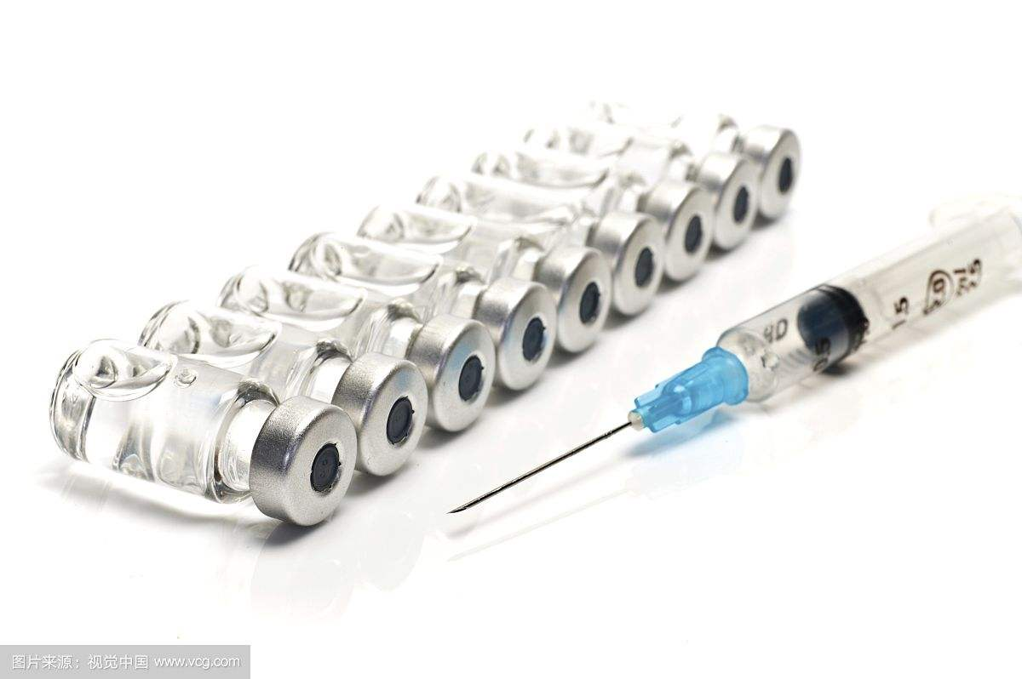
无菌制剂生产核查发现的主要问题 Major Problems Discovered in the Check of the Manufacture of Sterile Medicinal Products
韩新峰，河北绪必迪医药科技有限公司 Bert Han, Hebei QbD Medical Technology Co., Ltd
July 17 2019,

Slide 2
内容
无菌制剂产品开发注意点
Some considerations during the development of Sterile Drug Products
无菌工艺的选择
The selection of Aseptic processing
为什么注射剂是FDA短缺药品的常客
Why parenteral products are in the top lists of the FDA shortage drugs？
什么是FDA警告信？
What is a FDA warning letter?
无菌工艺主要问题汇总和案例分析
The case analysis and summary of the most common observations of Aseptic processing
研发和质量管理的一些体会
Some Experiences in R&D and Quality Management

Slide 3
注射剂市场
中国市场
95% 是仿制药， 化药中70% 是注射剂
美国市场
2014年FDA批的药中，80%以上是仿制药
2015年65%的处方是仿制药,
67%-80%市场短缺药是注射剂
2017-18年新药研发53%是注射剂给药

Slide 4
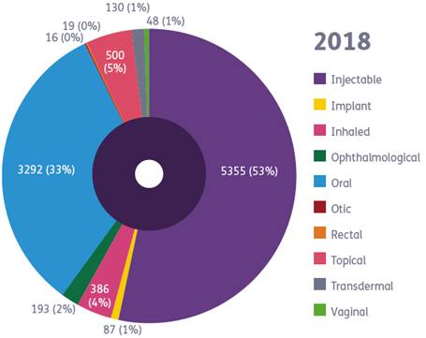
给药途径之分布, 2017-18 Distribution of Route of Administration, 2017-18
[详情请参阅Citeline®中的 Pharmaprojects®]

Slide 5
基本事实
注射剂可分为溶液型、注射用无菌粉末、注射用浓溶液以及乳剂、混悬剂、注射用油溶液、注射用微球、胶束、纳米粒、脂质体等特殊类型载药系统的注射剂
无菌药品质量保证的重点在于微生物、细菌内毒素和微粒的污染控制，同时也需要关注混淆和交叉污染。
采用最终灭菌工艺的为最终灭菌产品；部分或全部工序采用无菌生产工艺的为非最终灭菌产品

Slide 6
基本事实
灭菌方法通常包括湿热、干热、辐射、气体、过滤灭菌法
采用湿热灭菌方法进行最终灭菌的，通常标准灭菌时间F0值应当大于8分钟，流通蒸汽处理不属于最终灭菌。最终灭菌产品中的微生物存活概率（即无菌保证水平，SAL）不得高于10-6。
采用无菌生产工艺生产的产品比最终灭菌工艺生产的产品微生物污染风险高，影响因素多。在无菌灌装工艺中，产品、直接接触药品的包装材料分别灭菌后，在A级洁净区下灌装或分装，以降低微生物污染的风险。

Slide 7
研发的一些考虑：辅料的作用
To make the preparations isotonic 制剂等渗 with respect to blood (glucose/dextrose, mannitol, 甘露醇 sodium chloride…)
To adjust the pH to the physiological one (mineral or organic acids or salts)
To prevent the degradation of the drug substances (stabilizer…)
To ensure or increase the drug substance’s solubility
To provide adequate antimicrobial preservative property (only applicable to multidose preparations)

Slide 8
研发的一些考虑： 处方的优化
to achieve a good compatibility of the drug substances
the excipients (no formation of new impurities either by degradation of API or formation of new chemical entity between the API and the excipients)
the primary container (no leachable or adsorption to it).³
the drug substances should be soluble and remain soluble during the entire shelf-life of the products
The pH is one of the critical aspects of parenteral preparations which should have a pH close to the physiological one。 large volume preparations (LVP over 100 ml) should not contain a pH buffer

Slide 9
研发的一些考虑： 处方的考虑
The stability of the drug substance during the shelf life of the production.
When the use of a stabilizer is justified (for instance the use of mannitol 甘露醇 as free-radical scavenger or cysteine in paracetamol 对乙酰氨基酚中的半胱氨酸 solution for injection), it should be included at the minimum concentration demonstrated to be efficient at release and during the entire shelf-life.
a freeze-drying process :the use of bulking agent填充剂(such mannitol) and/or a cryoprotector 冷冻保护剂 will be needed when the dose of drug substance(s) cannot ensure solely the formation of acceptable “cake”.

Slide 10
内容
无菌制剂产品开发注意点
Some considerations during the development of Sterile Drug Products
无菌工艺的选择
The selection of Aseptic processing
为什么注射剂是FDA短缺药品的常客
Why parenteral products are in the top lists of the FDA shortage drugs？
什么是FDA警告信？
What is a FDA warning letter?
无菌工艺主要问题汇总和案例分析
The case analysis and summary of the most common observations of Aseptic processing
研发和质量管理的一些体会
Some Experiences in R&D and Quality Management

Slide 11
水针灭菌工艺决策树
产品可以在121℃湿热15分钟进行灭菌吗？
No
Yes
产品是否可以通过湿热灭菌Fo≥8分钟，使SAL达到10⁻⁶
在121℃高压灭菌15分钟
Yes
No
制剂可以通过微生物保留过滤器过滤吗
使用湿热灭菌，Fo ≥ 8 minutes
Yes
No
使用预先灭菌的单个组分，并采用无菌混合和灌装
采用无菌过滤和无菌处理相结合

Slide 12
非水针， 半固体或干粉灭菌决策树
产品可以通过160℃干热120分钟对进行灭菌吗
No
Yes
产品是否可以通过干热灭菌，选择时间和温度结合替代达到标准循环，达到SAL≤10⁻⁶？
在160℃下灭菌120分钟
No
Yes
产品可以通过不同于干热的方法进行灭菌吗，例如 吸收最小剂量≥25Kgy的电离辐射？
通过干热灭菌，选择时间和温度结合替代达到标准循环，达到SAL≤10⁻⁶？
Yes
No
制剂可以通过微生物保留过滤器过滤吗
通过验证过的照射剂量灭菌
Yes
No
使用预先灭菌的单个组分，并采用无菌混合和灌装
采用过滤和无菌处理

Slide 13
内容
无菌制剂产品开发注意点
Some considerations during the development of Sterile Drug Products
无菌工艺的选择
The selection of Aseptic processing
为什么注射剂是FDA短缺药品的常客
Why parenteral products are in the top lists of the FDA shortage drugs？
什么是FDA警告信？
What is a FDA warning letter?
无菌工艺主要问题汇总和案例分析
The case analysis and summary of the most common observations of Aseptic processing
研发和质量管理的一些体会
Some Experiences in R&D and Quality Management

Slide 14
为什么注射剂是FDA短缺药品的常客？
Injectable is a high risk product due to directly injecting to the blood stream
Sterile injectable products are notoriously difficult to produce,
and the FDA has little tolerance for plant issues that might lead to contamination.
FDA has found serious enough problems at Hospira， Mylan and Teva sterile injectables plants leading they to suspend operations
FDA drug shortage list updated weekly: almost 67% are injectable

Slide 15
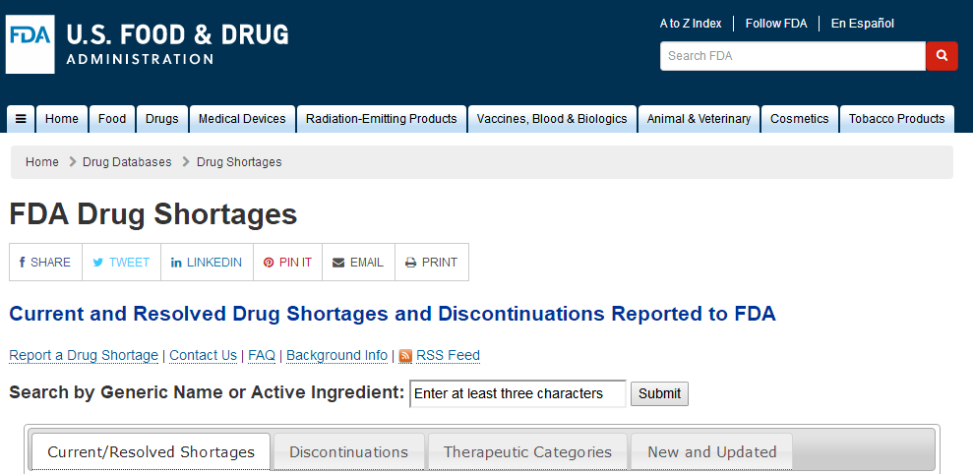
FDA短缺品种

Slide 16
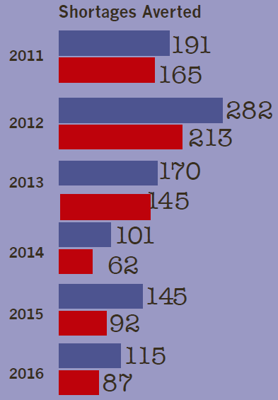
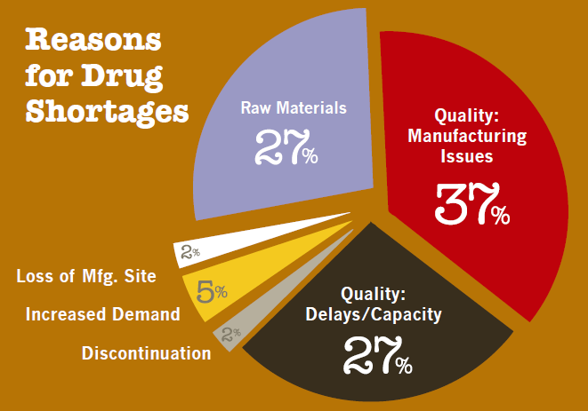
短缺品种大部分是注射剂
2018 | 短缺品种 | 注射剂品种 | %注射剂
4月2日 | 103 | 69 | 67
5月19日 | 114 | 76 | 67

Slide 17
由于收到FDA警告信件而关闭注射工厂的例子
Teva & Pfizer
May 2017 Teva Pharmaceutical is reportedly closing its sterile injectables plant in Godollo, Hungray and 500 workers could lose their jobs. The generics-maker is slated to close or sell the facility by the end of 2018
2019-1-14 Pfizer’s decision to close its legacy Hospira plants in Aurangabad and Irungattukottai, India, may have come as a surprise to employees, but the loss of about 1,700 jobs

Slide 18
什么是FDA警告信？
What is a FDA warning letter?

Slide 19
什么是FDA警告信？
An FDA warning letter is an official message from the FDA to a manufacturer or other organization that has violated some rule in a federally regulated activity
that notifies regulated industry about violations that FDA has documented during its inspections or investigations
is one of the Agency's principal means of achieving prompt voluntary compliance with the Act
should only be issued for violations of regulatory significance, i.e., those that may actually lead to an enforcement action if the documented violations are not promptly and adequately corrected

Slide 20
Outcomes后果
federal agencies may take this Warning Letter into account when considering the award of contracts.
Additionally, FDA may withhold approval of requests for export certificates, or
approval of pending new drug applications listing your facility,
FDA may re-inspect to verify corrective actions have been completed
if you are considering a decision that could reduce the production, please contact CDER's Drug Shortages Staff immediately at drugshortages@fda.hhs.gov.
decision to close its plants

Slide 21
Teva Godollo, Hungary
June 2016, FDA posted an import alert for cancer treatment bleomycin and antibiotic amikacin
10/13/16 FDA warning letter: You did not adequately investigate media fill and sterility test failures. These failures indicate that there is a lack of adequate sterility assurance in your manufacturing facility

Slide 22
Recently Posted Warning Letters
https://www.fda.gov/ICECI/EnforcementActions/WarningLetters/default.htm#recent
Letter Issue Date | Company Name | Issuing Office | Subject | Close Out Date
03/15/2019 | D’Andrea Foods Inc. | New England District Office | Seafood HACCP/CGMP for Foods/Adulterated/Insanitary Conditions | Not Issued *
03/14/2019 | Mariposa Labs, LLC | Los Angeles District Office | CGMP/Finished Pharmaceuticals/Adulterated | Not Issued *
03/13/2019 | One Way Drug LLC dba Partell Specialty Pharmacy | Los Angeles District Office | Compounding Pharmacy/Adulterated Drug Products | Not Issued *
03/12/2019 | Uustar Corporation dba Daily Vita, LLC | Atlanta District Office | Unapproved New Drugs/Misbranded | Not Issued *
03/06/2019 | Blacksmith ELiquid | Center for Tobacco Products | Family Smoking Prevention and Tobacco Control Act/Adulterated/Misbranded | Not Issued *
03/06/2019 | Thibiant International, Inc. | Los Angeles District Office | CGMP/Finished Pharmaceuticals/Adulterated | Not Issued *

Slide 23
FDA's Electronic Reading Room – Warning Letters
https://www.accessdata.fda.gov/scripts/warningletters/wlFilterBySubject.cfm
Archived warning letter

Slide 24
所有警告信都有一个相同的句子
we identified significant violations of current good manufacturing practice (CGMP) regulations for finished pharmaceuticals, Title 21, Code of Federal Regulations(CFR), Parts 210 and 211
What is CGMP？
What the special requirements for sterile products？

Slide 25
21 CFR part 211: cGMP
Holding &
distribution
Building&Facility
Equipment
Personnel
Drug Products
Records
Materials
Packaging&
Labeling
Container/closure
Returned Products
Production
Lab Control

Slide 26
Sterile Drug Products Produced by Aseptic Processing — Current Good Manufacturing Practice
IV. BUILDINGS AND FACILITIES
A. Critical Area – Class 100 (ISO 5)
B. Supporting Clean Areas
C. Clean Area Separation
D. Air Filtration
1. Membrane
2. High-Efficiency Particulate Air (HEPA)
E. Design

Slide 27
V. PERSONNEL TRAINING, QUALIFICATION, & MONITORING
A. Personnel
B. Laboratory Personnel
C. Monitoring Program
VI. COMPONENTS AND CONTAINER/CLOSURES
A. Components
B. Containers/Closures
1. Preparation
2. Inspection of Container Closure System
VII. ENDOTOXIN CONTROL.
VIII. TIME LIMITATIONS

Slide 28
IX. VALIDATION OF ASEPTIC PROCESSING AND STERILIZATION
A. Process Simulations
1. Study Design
2. Frequency and Number of Runs
3. Duration of Runs
4. Size of Runs
5. Line Speed
6. Environmental Conditions
7. Media
8. Incubation and Examination of Media-Filled Units.
9. Interpretation of Test Results
B. Filtration Efficacy
C. Sterilization of Equipment, Containers, and Closures
1. Qualification and Validation
2. Equipment Controls and Instrument Calibration

Slide 29
X. LABORATORY CONTROLS
A. Environmental Monitoring
1. General Written Program
2. Establishing Levels and a Trending Program
3. Disinfection Efficacy
4. Monitoring Methods
B. Microbiological Media and Identification
C. Prefiltration Bioburden
D. Alternate Microbiological Test Methods
E. Particle Monitoring
XI. STERILITY TESTING
A. Microbiological Laboratory Controls
B. Sampling and Incubation
C. Investigation of Sterility Positives
XII. BATCH RECORD REVIEW: PROCESS CONTROL DOCUMENTATION

Slide 30
内容
无菌制剂产品开发注意点
Some considerations during the development of Sterile Drug Products
无菌工艺的选择
The selection of Aseptic processing
为什么注射剂是FDA短缺药品的常客
Why parenteral products are in the top lists of the FDA shortage drugs？
什么是FDA警告信？
What is a FDA warning letter?
无菌工艺主要问题汇总和案例分析
The case analysis and summary of the most common observations of Aseptic processing
研发和质量管理的一些体会
Some Experiences in R&D and Quality Management

Slide 31
近年国际认证汇总无菌缺陷案例分析
企业编造生产记录和产品检验记录，随意变更工艺参数和设备:小罐发酵改成大的

Slide 32
CFDA 缺陷汇总

Slide 33
2019年国家局飞行检查汇总
一、产品无菌检查不符合要求
（一）多批次产品无菌进行复检。注射用克林霉素磷酸酯（规格0.3g，批号17010601；规格0.25g，批号：17010603）首次无菌检查不合格，企业未结合生产情况进行全面偏差分析，第二次无菌检查合格后将成品放行。注射用伏立康唑（规格：50mg，批号：16080113）首次无菌检验不合格，未经偏差调查，重复无菌检查合格后将成品放行。 （二）2017年8月23-25日停电期间，企业未对因培养温度失控受影响的5批注射用克林霉素磷酸酯和2批注射用左卡尼汀的无菌检验结果进行全面的风险评估，也未重新取样进行检验。

Slide 34
2019年国家局飞行检查汇总
二、生产过程控制不符合要求
（一）车间无菌区尘埃粒子、沉降菌、人员进出的接触碟的检测结果，多次发生超警戒限、纠偏限或超标准情况，虽然部分进行了偏差记录，但未进行全面的调查分析和风险评估，缺乏有效的纠正预防措施。 （二）注射用克林霉素磷酸酯（规格：0.3g，批号：17010601）动态监测沉降菌检验原始记录结果与质量负责人OA系统调取的《2017年1月生产车间监控异常登记表》中记录结果不一致。 （三）关于注射用克林霉素磷酸酯使用的橡胶塞，企业允许已灭菌未使用的零头胶塞退回仓库进行第二次清洗灭菌使用，但未开展胶塞二次灭菌的风险评估和质量分析。部分胶塞经三次清洗灭菌后使用。

Slide 35
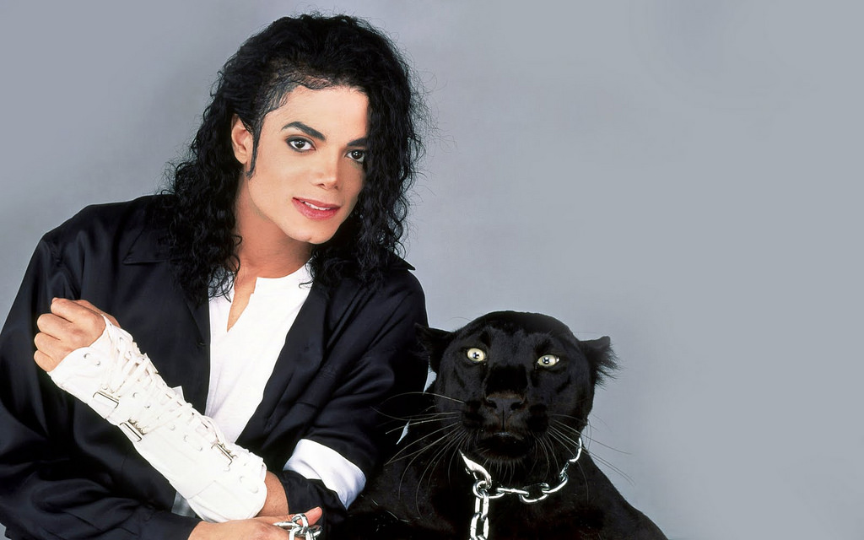
在Teva经历
国际无菌缺陷案例1
Teva

Slide 36
July13 to July 24, 2009 FDA 飞行检查
inspection of your pharmaceutical manufacturing facility,
Teva Parenteral Medicines, Inc. 梯瓦注射药物公司,
located at 19 Hughes, Irvine, California.
The inspection identified
significant violations 重大缺陷
of CGMP Regulations for Finished Pharmaceuticals

Slide 37
483 Observation Letter

Slide 38
TEVA无菌缺陷案例
Your firm's analysis of pooled samples from customer complaint vials of finished product (Lot#(b)(4)) revealed an endotoxin concentration of (b)(4). Your firm failed to identify a root cause and failed to implement a corrective action.
Your firm has not tested each lot of raw materials used in the manufacture of Propofol Injectable Emulsion finished products to determine the presence and levels of bacterial endotoxin
The study to support the chemical and microbiological stability of Propofol bulk emulsion was not based on sampling from the (b)(4) mixing vessel, but on samples drawn from a (b)(4) "pressure can."

Slide 39
TEVA无菌缺陷案例
For example, the bacterial endotoxin test methods used for the final release of Propofol Injectable Emulsion were not adequate to ensure detection of bacterial endotoxin as described below.
A) SOP (b)(4), is deficient because there is no requirement for vortexing the finished product vials of Propofol Injectable Emulsion prior to sample preparation.
B) The pH was not checked by mixing a portion of the sample preparation with (b)(4) first before adjusting the pH of the sample preparation solution

Slide 40
TEVA无菌缺陷案例
Your firm was unable to determine the cause of an out-of-trend level of bacterial endotoxin contamination found in three vials of finished product (Lot #(b)(4)) of Propofol Injectable Emulsion. No corrective action was taken in response to this finding at the time of manufacture, and your firm released the lot
your firm's finished product sampling plan for (b)(4) and (b)(4) in Propofol Injectable Emulsion is not representative of the batch produced. A total of thirteen units are sampled per lot, with three tested for bacterial endotoxin and ten tested for bioburden. This sampling of thirteen units is irrespective of lot size, which may vary from (b)(4) to (b)(4) units (vials) per lot.

Slide 41
未能建立并遵循适当的SOP
A.无菌注射液的设置和灌装期间不良的无菌行为：
an operator passing a pen directly over the stopper bowl to another operator.
an operator sitting on the clean room floor during set-up of the filling line and not changing the gown after standing up.
operators leaning against the cleanroom walls.
an operator 让无菌隔离系统 长时间打开 during filling line set-up, even when he was not working in the immediate area.

Slide 42
在回复此信时，请提供以下信息：
在检查期间观察到不良无菌技术的风险评估
a broader evaluation of any additional aseptic technique breaches that have occurred in your operation (e.g.,through review of videos).
updated information to demonstrate that each of your aseptic processing lines is in a state of control.
In addition to implementing enhancements to your aseptic processing operation design，描述如何提高员工能力，监督日常运营和其他控制。

Slide 43
未能建立并遵循适当的SOP
B.药液灌装期间的机械故障
在没有适当理由的情况下，由于灌装机械故障或其他原因，贵公司报废了许多整瓶药
没有SOP和程序去处理由于机械故障后生产的药品
在回复此信时，请提供以下信息：
a list of commercial batches rejected as a result of mechanical problems or other reasons and the CAPA that was implemented in each case.
a list of all media fills conducted since January 2011 with fill date, number of units run, number of units incubated, number of positive units, and annotation of whether the fill was aborted.

Slide 44
未能确保实验室记录包含完整数据
Our investigators observed colony counts菌落计数for environmental and personnel monitoring that did not match your official records.
For example, one contact plate from a Grade B area had a reported result of x CFU, but our investigator counted xx CFUs on the plate. Five other plates had reported results of yy CFU, although our investigator counted yyy CFU on each plate.
不准确报告环境和员工监测数据会不利于您在无菌处理操作中评估和控制的能力。

Slide 45
未能对计算机进行适当的控制
Your stand-alone computer systems lacked controls, such as routine audit trail review and full data retention, to prevent analysts from deleting data. Although you implemented a procedure to begin reviewing audit trails of your HPLC Empower system on January 11, 2016, you had not performed any reviews prior to our inspection
In response to this letter,
provide details of your retrospective review of the HPLC and other laboratory data, such as FT-IR, GC, UV , and (b)(4)analyzer data. Indicate the period covered in your review and your rationale for selecting that timeframe

Slide 46
未能按照适当的书面要求准备主生产和控制记录
Our investigators found quality-related documents in a waste bin.
Among these documents were an incomplete sterility test data sheet, a form used to track the movement of (b)(4) samples, a media fill incubation card, and others.
The incomplete sterility test data sheet had been filled out to track information about a “(b)(4)” sterility check.
After an error was observed on the original data sheet, the record was torn and discarded with no written explanation.

Slide 47
贵公司缺乏对实验室的控制
The suitability test you performed in (b)(4) failed to meet acceptance criteria for sterility testing. Specifically, a positive control sample did not exhibit growth of (b)(4) during sterility testing for (b)(4) mg/mL solution (b)(4).
Your firm did not investigate this failure of media to support growth.
Unsuitable sterility test methods increase the probability that your quality control test will not detect a non-sterile product

Slide 48
TEVA无菌缺陷案例
CGMP Consultant Recommended
we strongly recommend that your consultant, who should be qualified as set forth in 21 CFR 211.34, assist your firm in meeting CGMP requirements. Your consultant should provide a thorough assessment of your entire operation to identify contamination hazards, assist in remediation of sterility assurance in your facility, improve your quality system, and certify readiness
Data Integrity Remediation
Your quality system does not adequately ensure the accuracy and integrity of data to support the safety, effectiveness, and quality of the drugs you manufacture

Slide 49
Hospira无菌缺陷案例2
辉瑞 Hospira，印度 March 4， 2019
FDA对放行检验数据完整性担忧 微生物实验室数据完整性：
人员和环境监测培养基结果与实际不符。检查员发现培养基实物菌落数与记录数不一致，员工承认该严重错误，整改为实际计数，环境监测结果急剧增加。
FDA评论该厂微生物数据完整性问题使得该厂放行的药品的无菌性无法保证。
FDA对微生物实验室所有结果的有效性的表示严重担忧。
尽管辉瑞高层在FDA监管会议上沟通数据完整性的整改计划，但是FDA表示，该公司尚没有说明数据报告不准确的范围, 以及管理层和员工参与数据造假的程度。

Slide 50
整改：回复此函, 请包括
一份为确保无菌操作保持在控制状态而实施的纠正措施和预防措施的最终报告，包括对参与这些操作的人员进行全面再确认。
工厂QC实验室所实施的用以强化程序、培训，以及针对检查期间发现的和检查后评估发现的CGMP文件记录缺陷所做的变更的最终报告。
一份对所有微生物实验室数据可靠性进行全面回顾审核，包括但不仅限于与水系统控制和环境监测（人员、表面、空气）相关的数据。评估所有销售至美国仍在效期内的批次。

Slide 51
工艺控制不足：
Hospira无菌缺陷案例
FDA检查了该厂灯检不良情况，发现多个批次灯检关键缺陷不良超出规定的限度。
在对该厂的留样的检查期间，FDA再次发现了多个外观缺陷样品。
FDA评论该厂工艺对灯检关键缺陷的容忍度过高，质量部门未能及时发现生产的不良信息，使得几批有关键质量缺陷的药品进入市场。

Slide 52
贵公司未能彻底调查所有已销售和未销售批次及其组分的偏差或不符合其质量标准情况
生产调查显示高频次严重XX外观缺陷是因为断电和XX中断引起的。这些事件延误了在XX期间达到适当的XX，导致XX不足和不均匀。但是你们的调查并未充分确定在没有记录任何断电和循环偏差的情况下，批次仍反复出现严重XX缺陷的根本原因。你们的工艺控制问题允许制剂单元保持超出XX，导致了持续缺陷。这些XX工艺控制困难导致的XX被发现会导致不符合质量属性标准，包括杂质、含量或XX。
检查并未包括及时的CAPA计划，用以解决XX设计缺陷和关键缺陷（如XX）的不恰当的过高的容忍度。你们亦未说明是否需要充分仔细检查在你们XX设备的压力控制中的变量，包括更好地触发调查。
过多的缺陷和主要生产偏差都是不可接受的生产波动的信号，需要彻底调查工艺设计和控制的充分性。你们的运营和质量部门未能及时发现生产的不良信息，使得几批有关键质量缺陷的药品进入市场

Slide 53
整改：回复此函, 请包括
你们确保XX工艺能重复符合所需质量属性所需的改进的最终报告
用于生产美国市场药品的每个XX周期的设计和受控状态的评估，包括对所有与未从美国市场召回的XX药品有关的调查的回顾性评估（例如工艺偏差、不合格、投诉）。总结所发现缺陷归结的根本原因，CAPA的充分性和所需的更多步骤。
你们监管设施和设备用以确保及时发现设备性能问题、执行修理、完成预防性维护、设备和设施升级以及其它适当措施的常规、警戒操作管理CAPA

Slide 54
Hospira无菌缺陷案例
FDA对放行检验数据完整性担忧
化学实验室数据完整性：
FDA对几个已经检验合格的API and product 批次要求当场进行复测，结果均为OOS。
FDA发现该厂检验员没有用以记录时间的时钟。
FDA表示该厂未确定在相同进行的其它检验是否有数据完整性问题，也未讨论整个化学实验室数据完整性问题的程度。

Slide 55
你们公司未在放行前对每批药品进行适当的实验室检测，确定其符合药品的最终质量标准，包括每种活性成分的鉴别和剂量
我们知悉你们决定暂停所有的XX检测。但是，你们并未确定在相同实验室进行的其它QC实验室检测是否受数据完整性问题影响。你们的回复亦未讨论你们工厂内数据完整性问题的程度
关于OOS XX结果，你们说“过去执行XX检测的化验员并未根据程序进行检验，且未准确记录数据”。还有，“可能有时KF水分检测、气相、红外光谱和紫外光谱均有记录不准确的情况
回复此函, 请包括
一份全面CAPA，确保所有准备销往美国的XX成品批准符合既定质量标准。包括你们对所有销售往美国仍在效期内或复验期内药品（活性成分和制剂成品）留样的检测结果。
你们对留样检验为OOS或不准确报告（例如，你们独立第三方所发现的）的所有批次的市场行动计划

Slide 56
Hospira的决定
Pfizer stopped manufacturing 辉瑞停止了生产
recalled products from a Hospira sterile injectables plant in India that the FDA has repeatedly criticized.召回Hospira印度无菌注射剂工厂的产品,该工厂被FDA一再批评
It recently announced it would close the plant.辉瑞宣布将关闭该工厂

Slide 57
8/6/15Mylan无菌缺陷案例3
FDA检查了三个地点并发现了严重违反CGMP的行为
非完整手套用于进行无菌加工操作。
缺乏对制造环境的控制以及无菌加工的人员监控。
灌装区域中的无菌服装也是非完整。 我们观察到7件带孔破的无菌工作服; 8个松散的线头。 2个无菌罩。 8个无菌短靴
进出无菌区域的操作员过快，并且在灌装操作期间经常看到操作员相互撞击。
在灌装线中，在填充屏障内的活动完成后，屏障保持打开
您没有位于产品污染风险最大的地方的沉淀板

Slide 58
内容
无菌制剂产品开发注意点
Some considerations during the development of Sterile Drug Products
无菌工艺的选择
The selection of Aseptic processing
为什么注射剂是FDA短缺药品的常客
Why parenteral products are in the top lists of the FDA shortage drugs？
什么是FDA警告信？
What is a FDA warning letter?
无菌工艺主要问题汇总和案例分析
The case analysis and summary of the most common observations of Aseptic processing
研发和质量管理的一些体会
Some Experiences in R&D and Quality Management

Slide 59
R&D的一些体会
将R&D纳入药品质量管理体系，与GMP无缝衔接，R&D管理形成SOP，实现规范流程和操作管理。
除汇总FDA\EMA\NMPA以及ICH技术指导原则作为通则外，比如注射剂研发，还要兼顾FDA的具体产品的Draft Guidance 和PDA的具体要求，总之要融通规范要求的细节。
整个R&D过程中QbD的思维运用，DoE实施。一切的结果得出基于风险评价、基于科学统计、基于系统确认。

Slide 60
QM的一些体会
质量管理体系的建立基于ICH Q10，建立药品生命周期管理的药品质量管理体系，不仅仅是符合FDA\EMA\NMPA的现行GMP要求。
每个SOP的编制要理解规范的内涵，比如清洁验证，除了GMP规定外，还要将PDA\APIC等指南通晓，SOP中自然形成了清洁可接受标准建立流程，对清洁方法需进行分析方法学验证。
企业质量文化对质量管理体系的运行成效具有重要作用，质量管理是对药品全生命周期的管理。

Slide 61
thanks

