Slide 1
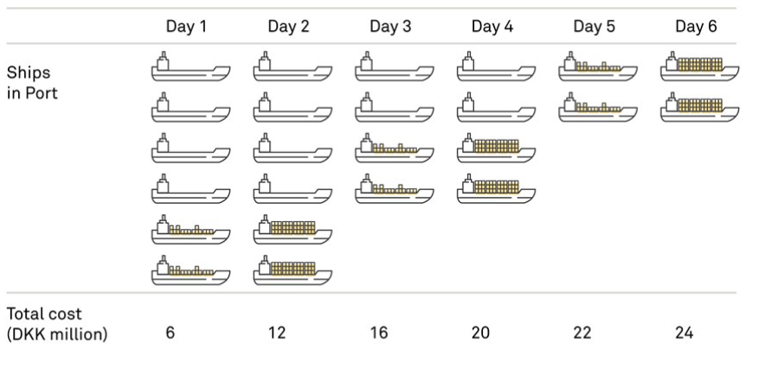
“A container terminal in South America”
The smart decision
Ships
in port
Total Cost
CNY million

Slide 2
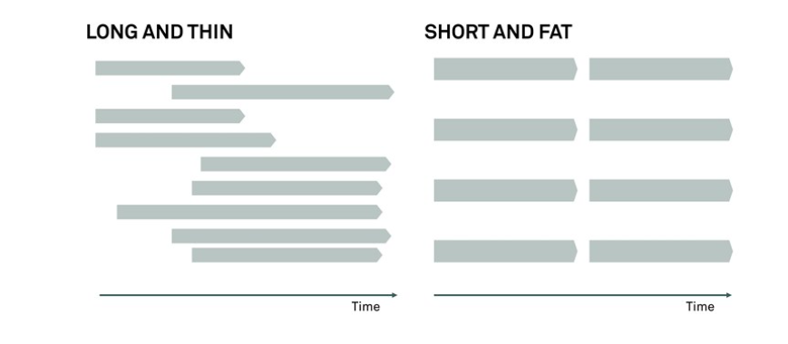
Project Portfolio execution
The easy decision
The smart decision

Slide 3
Key points to remember about project portfolio management:
It is absolutely necessary that some-one assumes responsibility at portfolio level
The effect of projects must be taken into account as a crucial factor in the prioritization of the project portfolio
Spreading one’s scarce resources between too many projects is damaging to the bottom line – and to the scarce resources
Project portfolio management is about making trade-offs – less is more
The notion of equality is poisonous to an efficient project portfolio
Remember the numbers 2 (number of concurrent projects per project participant) and 5 (maximum number of must-win battles)

Slide 4
Project Management
Do the project right

Slide 5
The Classic project triple constraints
Scope
30%
OF ALL PROJECTS TODAY ARE CHARACTERISED AS SUCCESFUL
Standish Group, 1994-2015
Cost
Time

Slide 6
The new project triple constraints
Impact
IMPACT: Stakeholder satisfaction is the ultimate success criteria
LEADERSHIP:
Embrace uncertainty an make It happen
FLOW:
High intensity and frequent interaction to ensure continuous project progression
flow
Leadership

Slide 7
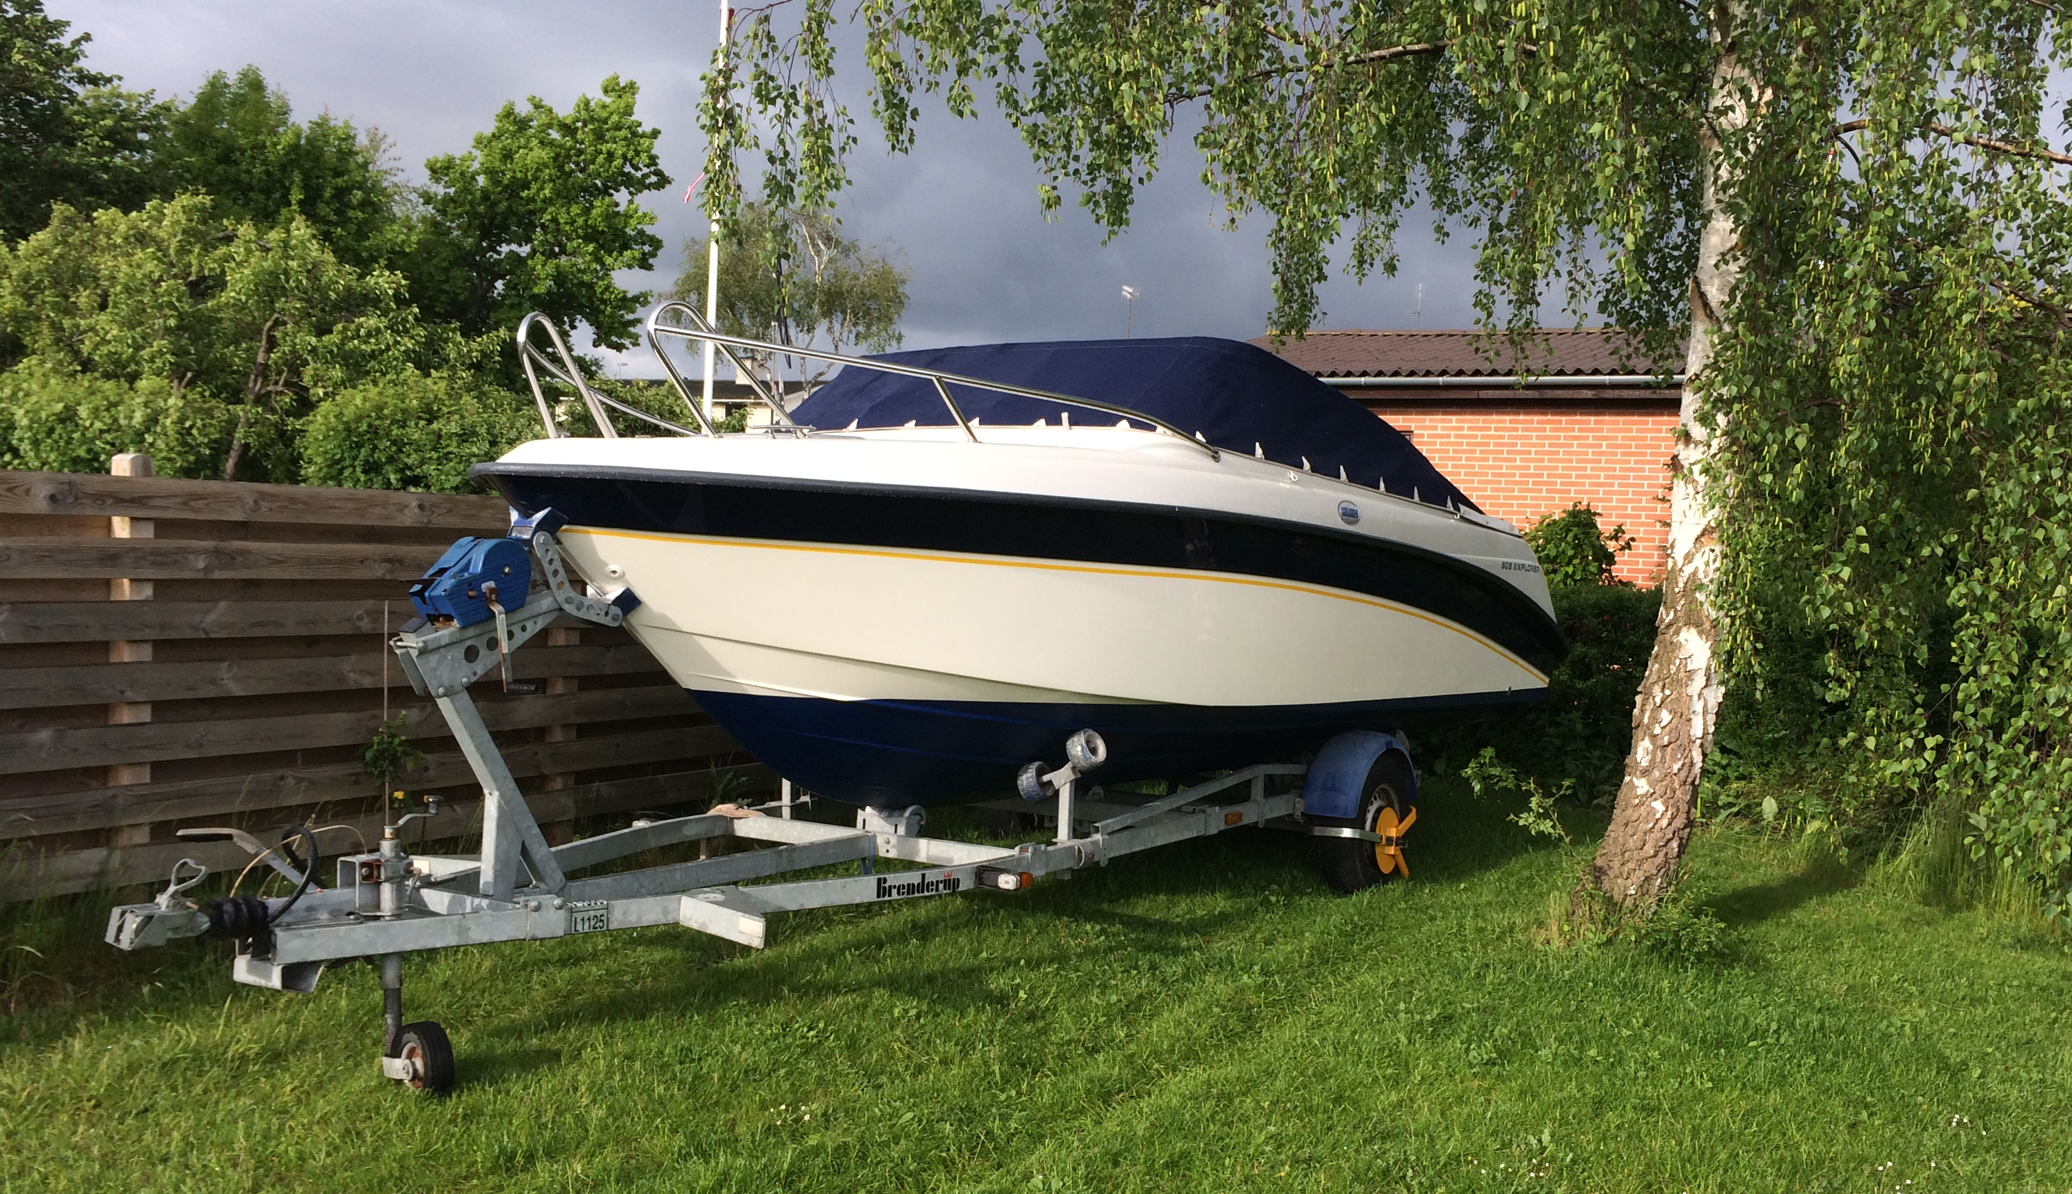
Impact Stakeholder satisfaction is the ultimate success criteria
MS IMPACT
Notes:
Small Changes ~ Big impact
Retagging ~ Impact Automation
Relocate sample valve
Reduce number of mplc column

Slide 8
Impact Stakeholder satisfaction is the ultimate success criteria
The user is not the Client
HIPPO – Highest Paid Person’s Opinion
The better we can manage stakeholders on all levels of the project the better project
One Page Project Strategy
Mission
Objectives – Impact
Design Drivers
Changing needs on different levels
High complexity projects require increased efforts on impact evaluation
Identify Changes – issue letter
Avoid Scope Creep

Slide 9
Leadership
Leadership will embrace uncertainty and make It happen
Active Project Ownership
Own the Impact
Ensure resource commitment
Show up and engage
Collaborative leadership approach
LEAD the Impact
Facilitate interactions
Put people first
Reflective and adaptive mindset
Say yes to the mess
Embrace Key Stakeholders
Know yourself
Notes:
Mirror effect – show enthusiasm
Reduce use of e-mails
Say yes to the mess – Peter Michael Holm
Embrace –one big family, trust
Both management and leadership are needed
Leadership should be in the drivers seat and all management effort should follow leadership need

Slide 10
Flow
high intensity and frequent interaction to ensure continuous project progression
Team
Allocate core team +50%
Colocation
Work shop approach to kill complexity
Heartbeat
Rhythm in key events
Make it visual
Visual Planning
Board meetings

Slide 11
Short & sweet
Trust
Parkinson’s law
Kill Complexity

Slide 12
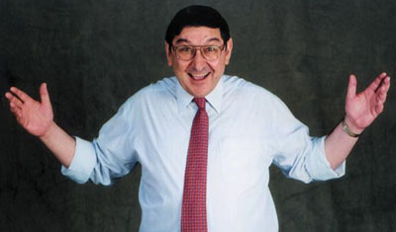
TRUST
TRUST =
CREDIBILITY + RELIABILITY + INTIMACY SELF-INTEREST
David Maister

Slide 13
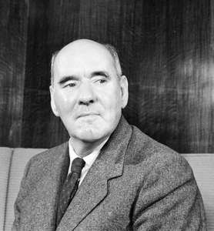
Parkinson’s law
”Work expands so as to fill the time available for its completion”
Northcote Parkinson

Slide 14
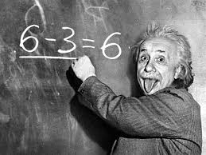
Kill Complexity
”Any intelligent fool can make things bigger, more complex and more violent. It takes a touch of genious - and a lot of couraget - to move in the opposite direction”
Albert Einstein

Slide 15
Thank you
jipsen@yahoo.com

