Slide 1
Project Management in a pharma setting
by Jacob Ipsen

Slide 2
JacoB Haahr Ipsen PMP
2015- : Project Manager Novo Nordisk
2013-2015: Project Manager Rambøll
2006-2013: Project Manager NNE
2002-2006: Construction Manager, NNE
1999-2002: Project Manager Novo Nordisk
1994-1999: Commissioning Lead
1989-1994: Marine Engineer
1988 : B.Sc Marine Engineering

Slide 3
Novo NordisK History
Portfolio Management
Project Management
Short and sweet
Novo Nordisk 1923 - 2019
Do the right projects
Do the projects right
Trust
Parkinson’s law
Kill Complexity

Slide 4
Novo NordisK History
1923 - 2019

Slide 5
The Beginning
1921: First insulin produced in Canada by Charles Best and Frederick Banting
1922: Professor and Nobel Prize winner August Krogh travel to US (by boat) together with his wife Marie Daily reports of people being treated with insulin. Marie Krogh a doctor and researcher with several patients with type 1 diabetes and type 2 diabetes herself. She persuade her husbond to contact Professor MacLeod in Toronto, head of the institute where the first insulin are produced. The all meet in Toronto and the couple return to Denmark in December 1922 with permission to produce insulin December 21’th 1922, the first insulin is extracted in Denmark from bovine pancreas.
1922 March 1923 is the first patients treated with insulin NORDISK IS BORN (NORDISK)
August and Marie Krogh

Slide 6
the Early Days
1924: NOVO IS FOUNDED
1932: Steno Hospital
1936: Novo and Nordisk in court
1938: Hvidøre Hospital
1950: Nordisk launch NPH
1953: Novo launch Lente
1974: Nordisk launch HPP
1977: Novo Launch MC insulin
1982: Novo develop Human Insulin
1984: Nordisk introduce Human Insulin
1989: Novo and Nordisk merge
1958. Frozen pancreas are disintegrated

Slide 7
Novo Today
Proucts sold in 170 countries
Affilliates in 80 countries
Employ 43,200 people
207,000 shareholders
29,200,000 people use diabetes care products
Obesity, Growth disorders, Haemophilia
Research in: China, Denmark, India, UK & US
Supplyer of nearly half of the world’s insulin
The most valuable company in Scandinavia
What made Novo Nordisk such a great company? Business Skills, Courage, R&D, Leadership…… All true but what made it happen….?
PROJECTS
Site Kalundborg

Slide 8
Portfolio Management
Do The right project

Slide 9
“Availability is not a skill set”
Stanford, Mastering the project portfolio

Slide 10
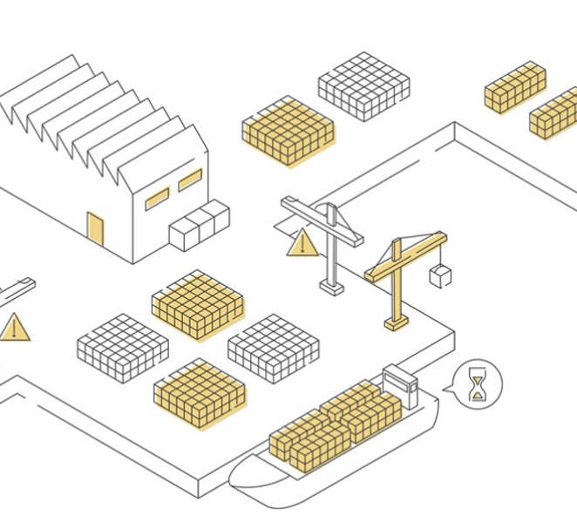
“A container terminal in South America”
Only 1 crane is working
Capacity 2,000 TEU vessel/day
One Monday morning, six container ships arrive at exactly the same time
All six ships are of the same size: 2,000 TEU
The six captains are all eager to get started loading
1 MCNY ship/day
What is the best plan for the unloading and loading of the six ships?
What is the total cost for the ship owners of having their ships to wait in port?

Slide 11
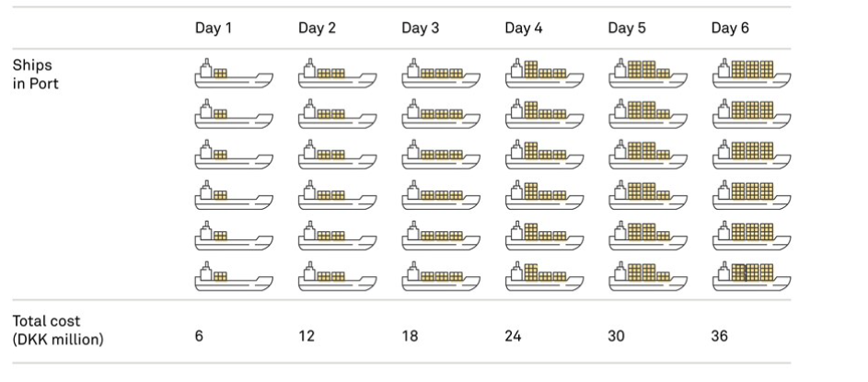
“A container terminal in South America”
The easy decision
Ships
in port
Total Cost
CNY million

Slide 12
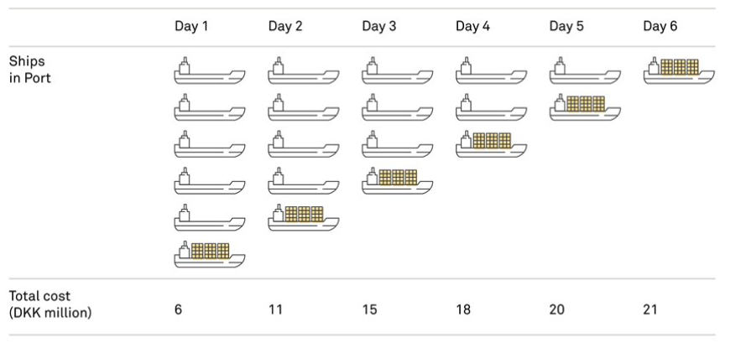
“A container terminal in South America”
The brave decision
Ships
in port
Ships
in port
Total Cost
CNY million
Total Cost
CNY million

Slide 13
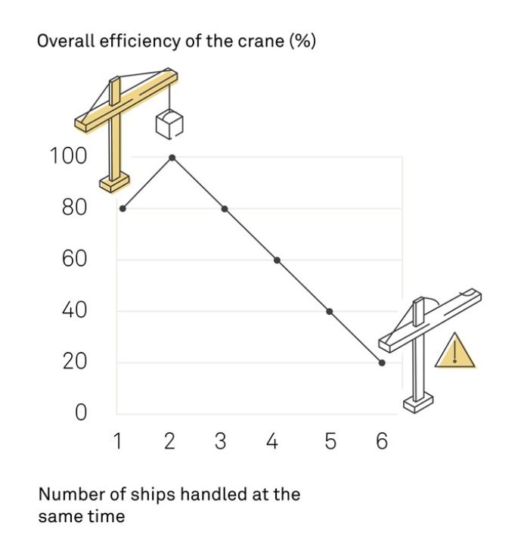
“A container terminal in South America”
If the crane is to handle too many ships at the same time, its efficiency is dramatically reduced due to the shifting between ships, which is highly time-consuming. In this way, there is also no particular focus for the crane during a day
If the crane is to handle only one ship at a time as opposed to two, the waiting time will increase as the crane from time to time will have to wait for the ship’s crew to handle deck hatches and the like. Mentally, the crane operator also prefers to shift between two ships

Slide 14
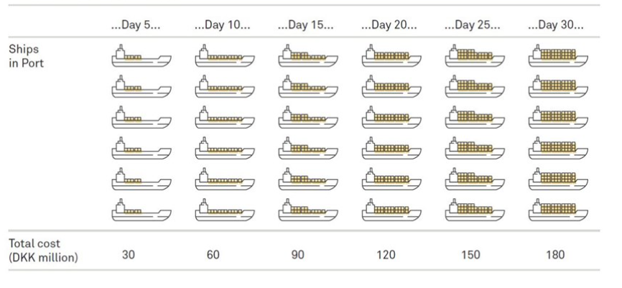
“A container terminal in South America”
The easy decision - revisited
Ships
in port
Total Cost
CNY million

Slide 15
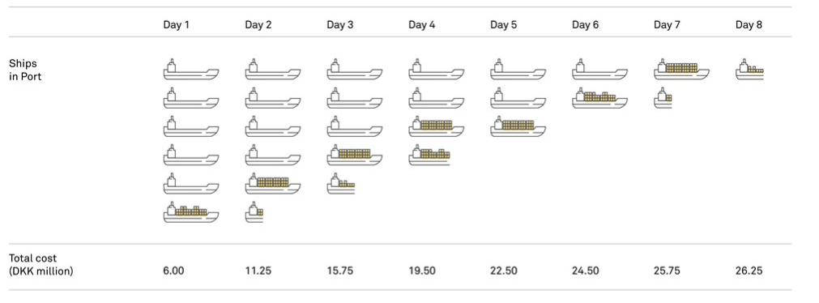
“A container terminal in South America”
The brave decision - revisited
Ships
in port
Total Cost
CNY million

