Slide 1
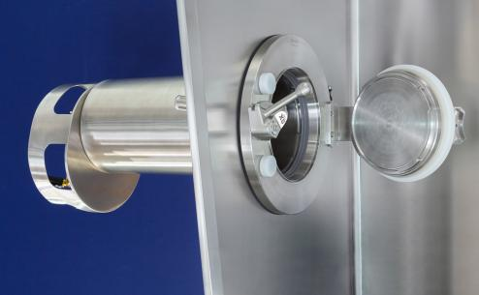
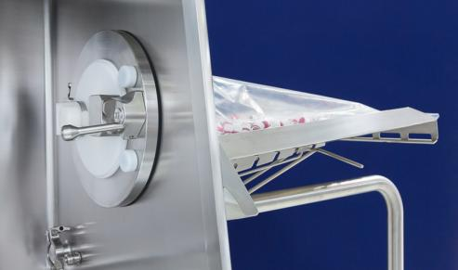
DPTE® solutions
The 11th Vogel Pharmaceutical Engineering International Forum 2019
Getinge Safe Sterile Transfer System
Disposable vs reusable

Slide 2
GETINGE La Calhène Center of Excellence for isolators and DPTE®
Vendôme (France, 41)
8 600 m2 (92,600 sqf)
More than 220 employees
Center of Excellence for isolators since 70’s (3200+ isolators designed and manufactured worldwide)
The DPTE® inventor
ISO 9001 V2015 &14001 (LRQA) certified

Slide 3
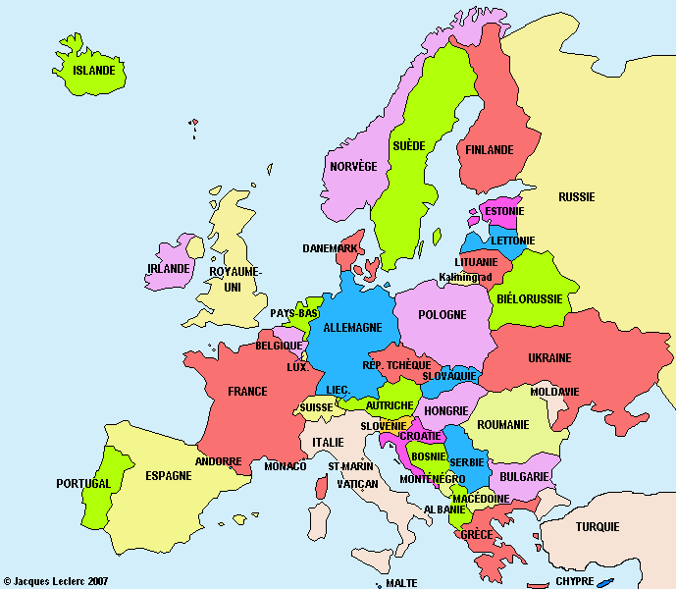
GETINGE La Calhène Center of Excellence for isolators and DPTE®
Getinge Sweden AB
PO Box 69
Getinge
SE 310 44 Sweden
+46 35 155500
info@getinge.com
Getinge La Calhène
1 rue du Comté de Donegal
Vendôme
FR 41102 France
+33 254 734 747
Getinge Lancer
30 Boulevard de l'Industrie
Tournefeuille
FR 31170 France
+33 561 151 111

Slide 4
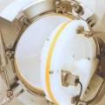
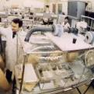
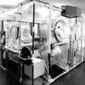
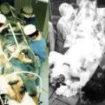
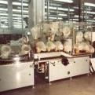
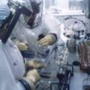
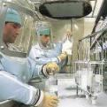
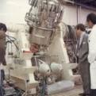
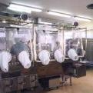
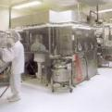
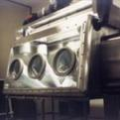
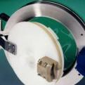
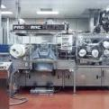
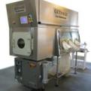
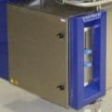
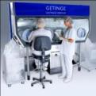
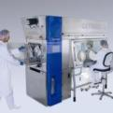
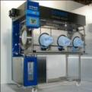
50 years of innovations, a long journey!
1963
1967
1972
1972
1974
1975
1975
Protection of RAMSES 2 mummy
DPTE® transfer system
Animals lab. isolators
Isolator for patient care
Isolator for patient care
Aseptic surgical isolator
Dressing isolator
1978
1981
1984
1986
1987
1989
1992
Isolator for parenteral nutrition mixing
Isolator for Large Volume Parenteral
Isolation of a complete line of cytotoxic product
Isolator for powder filling
Isolator for sterility testing
Isolator for powder transfer
Isolator for liquid filling
1993
1993
1998
1999
2005
2008
2008
Isolator for handling of hazardous powder
DPTE-S : total secure transfer system
INVANZ : the longest filling line isolator in the world
Isolator for beverage filling line
ISOTEST isolator for sterility test
STERITRACE - HPV sterilizer
FREJA - Isolator for cytotoxic in hospital
2010
2011
2012
2015
ISOTEST - Isolator with integrated Steritrace
ISOFLEX - Flexible wall isolator with Steritrace
DPTE-XS : eXtra Safe
ISOFLEX-R – Modular aseptic isolator

Slide 5
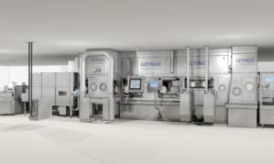
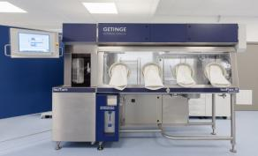
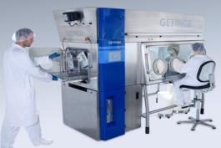
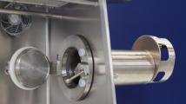
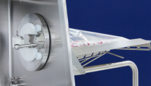
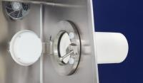
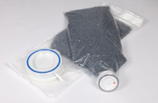
Biopharma applications

Slide 6
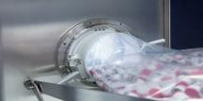
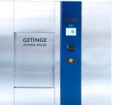
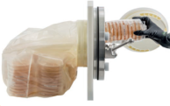
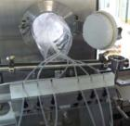
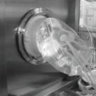
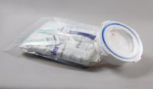
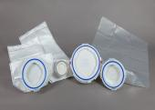
BIOPHARMA – 75% of Getinge La Calhène production
Aseptic filling

Slide 7
DPTE®
DPTE® Alpha – History and functionalities

Slide 8
DPTE® transfer system – History
1963
1st DPTE® Transfer System is developped by La Calhène for transfer of highly toxic nuclear material
1993
2012
DPTE®-XS is developped for an improved degree of safety with its locking system
DPTE®-S: Alpha door cannot open if the Beta component is not correctly connected or positionned.
The devices cannot be separated if the Alpha-Beta door assembly is open

Slide 9
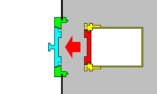
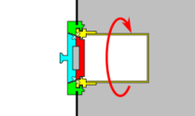
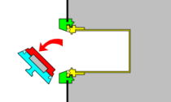
DPTE® principe https://www.youtube.com/watch?v=gBnQKd_SYRs
Alpha Part
Beta Part
DPTE® consists of 2 assemblies:
Alpha flange and alpha door: Alpha part
Container flange and alpha door: Beta part
2 lip seals meeting at a point
In final, 4 elements mutually shielding each other’s faces, locked together by rotation of the Beta part
After container docking onto Alpha flange, a 60° rotation of the container allows during rotation motion:
Locking of container with Alpha flange
Locking of container door with Alpha door
Unlocking of container door from container flange
Alpha ports can be integrated on:
Isolators / glove boxes
RABS
Clean room walls
LAF / BSC…
DN105, 190, 270, 350 (460)
1. Approach
2. Locking
3. Opening

Slide 10
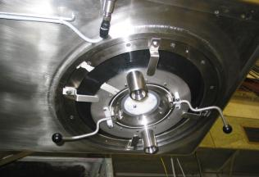
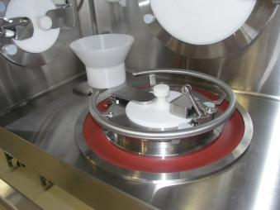
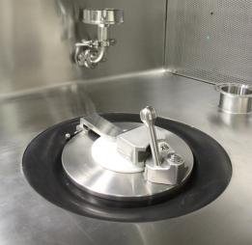
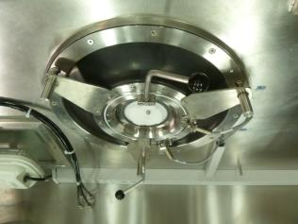
Rotating DPTE® alpha
Rotation of alpha port instead of beta
For large IBC / vessel docking
For docking of beta parts that can not be rotated

Slide 11
DPTE® Beta
DPTE® Beta - containers

Slide 12
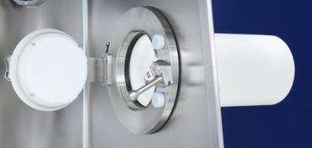
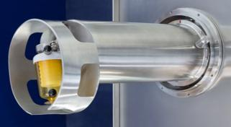
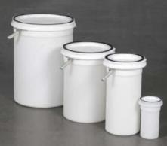
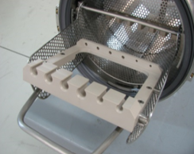
DPTE® CONTAINERS

Slide 13
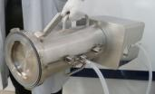
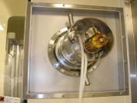
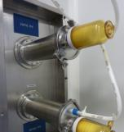
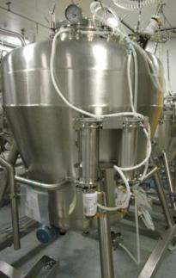
DPTE® CONTAINERS - Miscellaneous
DPTE® Beta – Reusable devices

Slide 14
DPTE® LIQUID TRANSFER CONTAINERS - Concept
Autoclave sterilization
Filling needle and hose can be sterilized inside DPTE® container
Sterilization step
Production step
Autoclave chamber
Filling Isolator
Vent filters for autoclaving
Sterilization of tank and DPTE® together in autoclave
Operation

Slide 15
DPTE® LIQUID TRANSFER CONTAINERS - Concept
SIP sterilization
These containers usually in 316L are mainly used with a filling isolator or RABS or clean room.
They are sterilised along with the tank, diaphragm valve open and with a specific cover (resistant to high pressure)
If necessary, product sterilization filter between thank and container (not possible for suspension)
Silicon J3L seals
Filling needle and hose usually not sterilized inside DPTE® container
Sterilization step
Production step
Filling Isolator
Steam
Sterilization of tank and DPTE® together
Operation

Slide 16
DPTE® LIQUID TRANSFER CONTAINERS - Example
Photos

Slide 17
DPTE® CONTAINERS - Accessories
DPTE® Beta – baskets, internal arrangement, trolleys…

Slide 18
DPTE-BetaBag®
Material - applications

Slide 19
Getinge Vendôme – Sterile packaging
2 Cleanrooms in Vendôme
More than 1000 m² Controlled Atmosphere Areas
Total traceability of products
100% product inspection
Strict gowning regulations
Over 150,000 DPTE-BetaBag® products manufactured in 2018.
Cleanroom manufacturing
The DPTE-BetaBag® is manufactured in highly regulated ultra-clean conditions and contributes to security in biopharma production.

Slide 20
DPTE-BetaBag® - various material
Name: DPTE-BetaBag® RTU*
DPTE®: Polyethylene
Diam: 105, 190 & 270 mm
Bag: PE & PU
Gamma sterilization
(RTU*)
Name: DPTE-BetaBag® RTS-PC**
DPTE®: PSU or PC
Diam.: 105 & 190 mm
Bag: HDPE - Tyvek®
Autoclave or ETO
(RTS**)

Slide 21
DPTE-BetaBag®: more than a bag
The validation of our DPTE-BetaBag® complies with international regulations:
Mechanical validation
- validated for up to 5 connexion / disconnexion
- Leak tight testing of DPTE® beta unit
- Leak tight testing of bag welded onto DPTE®
- Seal strength of the bag
Sterility validation (Gamma irradiation cycle between 25 and 50 kGy)
Microbiological validation
- Bioburden
- Endotoxin level
Particulate validation
DPTE® Security and Leaktightness

Slide 22
DPTE-BetaBag® - Components transfer
Stoppers, caps, pistons, plastic vials…

Slide 23
DPTE-BetaBag® - Components transfer
In-house « filling station »…

Slide 24
DPTE-BetaBag® - Waste management
Stoppers, caps, pistons, plastic vials…

Slide 25
DPTE-BetaBag® - Single Use – Liquid transfer
Partnerships with liquid transfer experts

Slide 26
DPTE-BetaBag® - media plate
Isobag® from Merck Millipore

Slide 27
Transfer Leak Tester TLT for DPTE®
Material - applications

Slide 28
TLT ( TRANSFER LEAK TESTER)
Market drivers:
Compliance to the regulatory and inspection organization.
The TLT system is used to test the DPTE® systems (Alpha and Beta) prior to or after the production cycles.
Standard features:
100Vac to 230Vac (CE & UL compliance).
Compliant to the FDA 21 CFR part 11 and EU annex 11.
Full traceability recorded on SQL Database.
Pipeless and wireless.
Alpha and Beta transfer test (105, 190, 270, 350)
Multiple tests can be done simultaneous.
Customer IT connectivity available for user access control (ex Active Directory), for SQL Dabase backup, server printer, pdf file records….
Stand alone or integrated into the isolator for the Alpha transfer (Control and Traceability included in the isolator HMI)
50µm hole detection

Slide 29
TLT ( TRANSFER LEAK TESTER)
Tablet 11.9 inches for control and traceability.
Windows 10 and SQL server 2016.
Plug with inflatable gasket. Wireless and pipeless.
Battery (10 cycles of capacity)
Trolley connected to electrical power and Ethernet port (available) for storage and batteries power loading
Push button for gasket command.
Lighting for information and battery status.
Dedicated support for storage and power loading
Notes:
Very similar unit

